Slide 1

We make the road by walking.
Health and social care partnership to tackle homelessness
Andrea Rodriguez; Smile4life Programme, University of Dundee
Ailsa McAllister; Dundee Health and Social Care Partnership

Slide 2












Slide 3
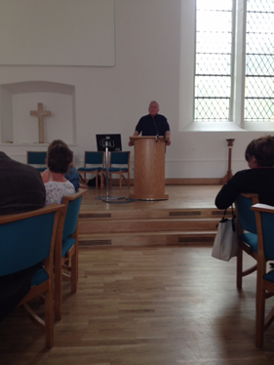
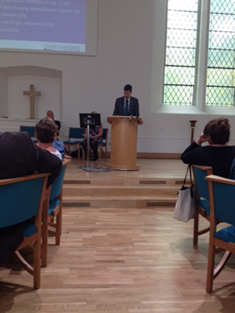

Ed Mitchell
TV presenter who ended up homeless in late 80s.
Local Councillor John Alexander

Slide 4

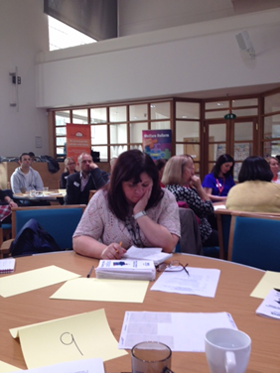
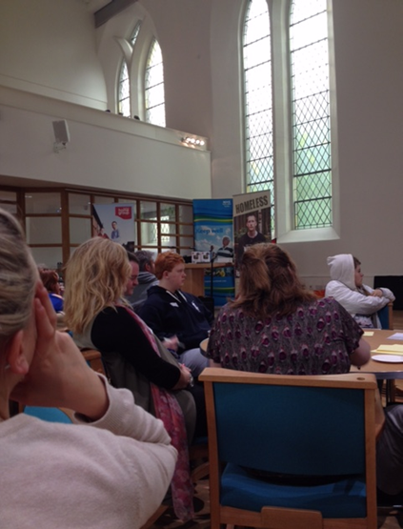
Diary Room with Big Brother!
With
People living in hostel accommodation
Staff Consultation and Involvement contributing to the development of the Strategy.

Slide 5
Not just a Roof!
Not focusing on the bricks mortar and finance that previous strategies had. But is more focused on the underlying issues and the supports required for people facing or who might end up homelessness.

Slide 6
Was developed and co-produced including:
Lately:
City Ambassadors from Dundee City Council
Parish Nurses
Health and Social Care Partners
Third Sector Partners
Police Scotland
Dundee University

Slide 7
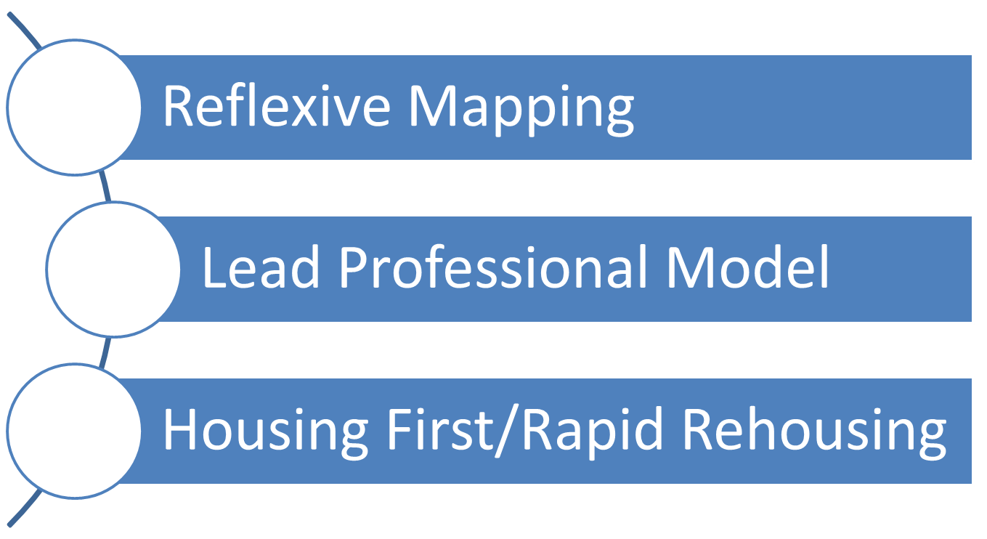
Achievements to date!
‘Not Just A Roof’ introduced some new ways of working relating to responding to and preventing homelessness. This then led to the development of a complete co-produced Transformational Change Programme.

Slide 8
Reflexive Mapping
Mapped out geographically different types of services under outcome headings for homeless and potentially homeless people
Useful for all groups of people
Noted that many services only accessible in City Centre, locations limiting access to those who live in the surrounding areas/localities.
Consideration of access in relation to transport, timings of appointments, being able to make appointments, money and access to a phone/computer to make appointments.

Slide 9
The Lead Professional Process
One person responsible for calling the meeting and pulling together all people/staff deemed to be useful in supporting the person out of crisis into and through recovery.
Agree with the team who is best placed to be the Lead Professional with the persons input.
Record the meeting and the personal outcomes the person wants to work towards with support.
Set a date to come back together to review the outcomes
Agree
Record
Call
Review

Slide 10
Review of Temporary Accommodation
Acknowledgment that temporary accommodation was no longer ‘fit for purpose’. More of a focus on supported accommodation required.
Feedback from service users was not always positive about this type of accommodation for many reasons.
A change was required to redirect some of the resources from this type of service model into more community based supports.
Housing First funding has allowed for the plans to be made a reality quicker than was first thought.

Slide 11
Housing First (HF) and Rapid Rehousing (RR) developments in Dundee
Dundee City Council is one of the 5 Pathfinder local authorities for Housing First.
Consortium: Transform Community Development, Salvation Army, Addaction and Dundee Survival Group to deliver intensive housing support for the programme.
Anticipate further funding to upscale Housing First to 100 tenancies over 2 years.
Have appointed a Project Co-ordinator and recruiting support workers.
Referral protocol developed. Working with DCC Housing and HSCP on first tenancies.
Plan 33 HF tenancies over yr 1 (Housing First Pathways Project) and to extend to up to 100 units over two years.
Work with HSCP to assess effectiveness and levels of need to consider mainstreaming.
Projected support needs would predict ongoing demand for HF.
HF properties are within the overall rehousing supply projections.
Possible HF type model with on-site support for prison discharge.

Slide 12
Future co-production
Joint Commissioning Strategy bringing all resources to the table that all agencies have to offer to the agenda.
Finance, Workforce, Buildings, Capital.. Etc..
Focused on delivering supports in each of the 8 Localities in Dundee.
Informed by reflexive mapping,
Supported by the Lead Professional Model,
Housing First/Rapid rehousing Models.

Slide 13



Multi-sector working strategies to tackle homelessness:
Dundee city as an example

Slide 14
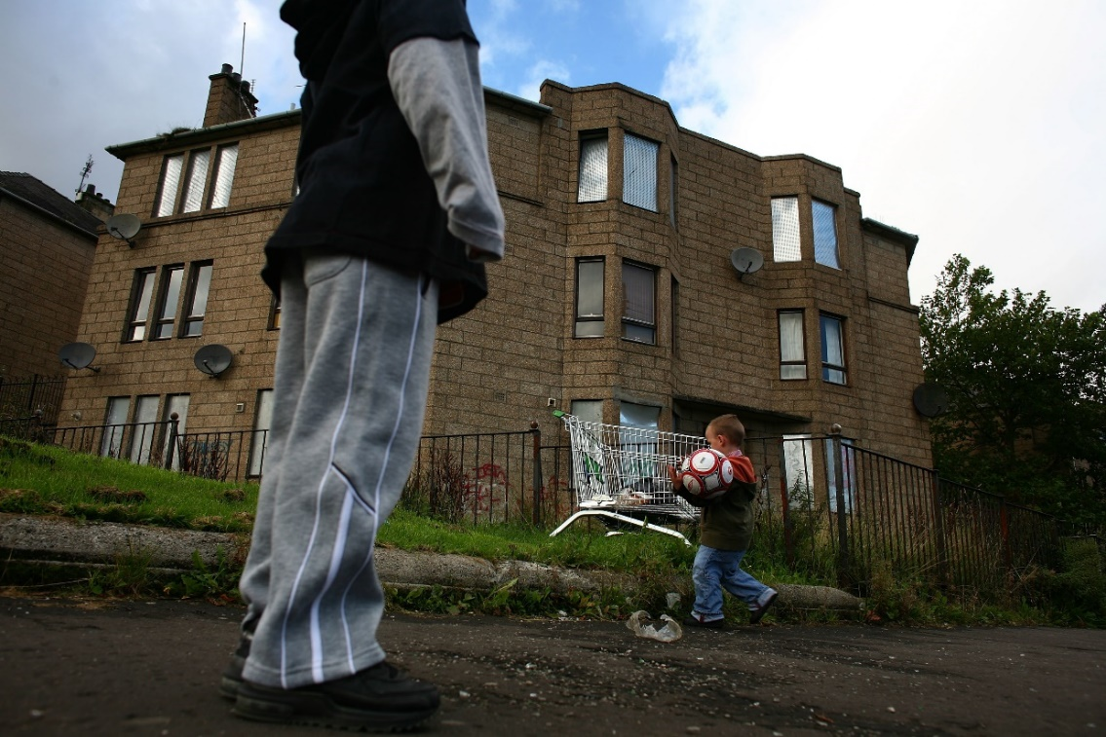
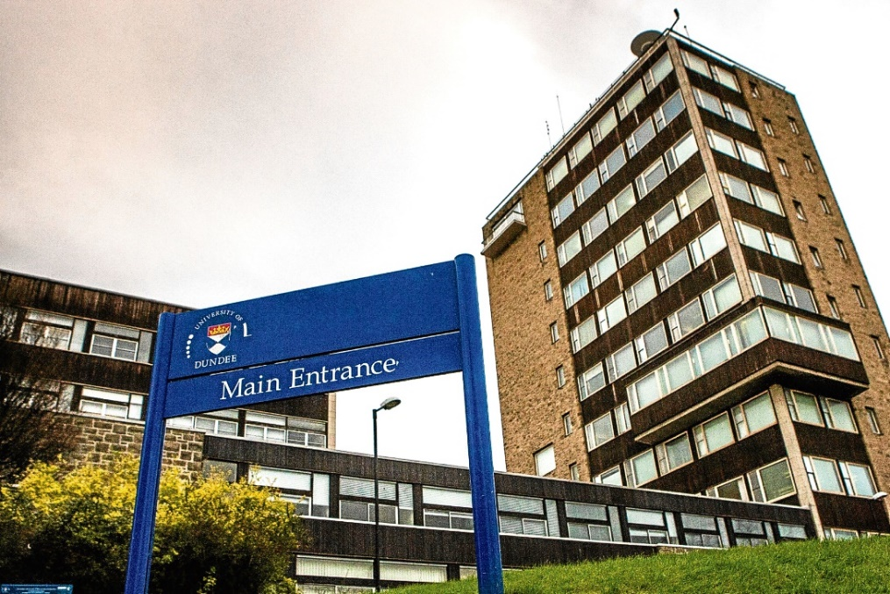
The Role of University
22% of the UK population living in poverty (Joseph Foundation, 2018)
7% in a persistent poverty
Child poverty increased 15%
Child and adolescent poverty leading to the generation of future populations of homeless (Bramley & Fitzpatrick, 2018)
‘Dundee’s greatest shame: New figures reveal 28% of city’s children growing up in poverty’
The Courier, 2018

Slide 15
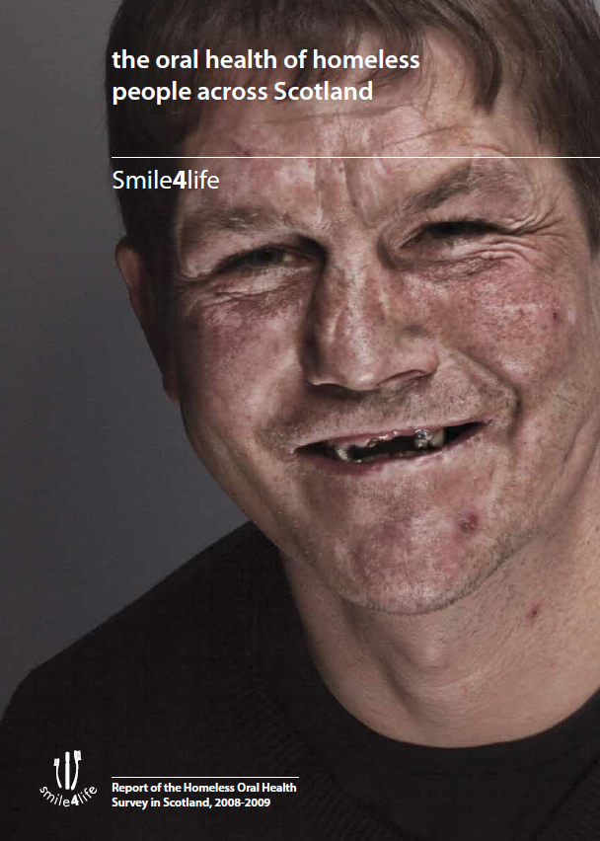

Smile4life
Created in 2007 in response to the ‘Dental Action Plan’.
Oral health and psycho-social needs assessment
Guide for trainers
Need for better integration between health practitioners and NGOs
www.dundee.ac.uk/dhsru/docs/smile4life_report2011.pdf

Slide 16
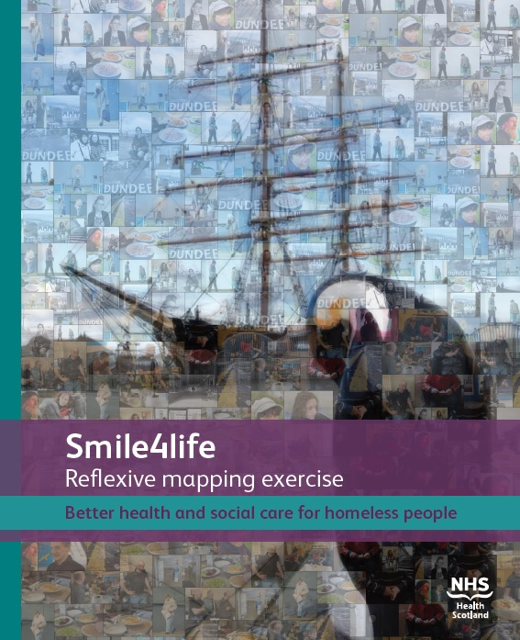
Reflexive Mapping Exercise of Services in Dundee
Covering 8 areas of support:
Housing Support
Health and Psychosocial Wellbeing
Food Assistance
Information and Advice
Education and Training
Furniture support
Community development network

Slide 17
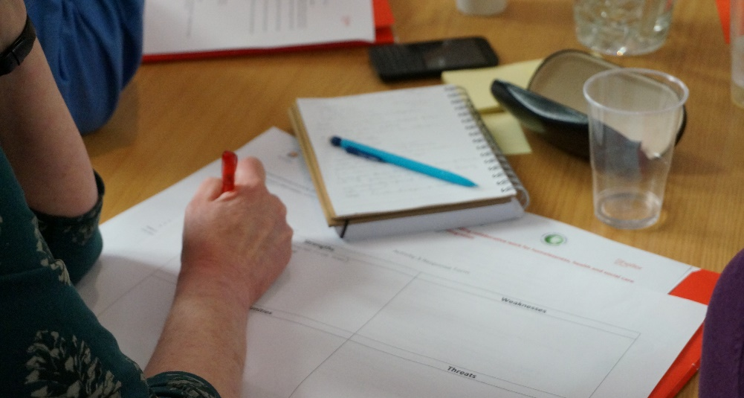
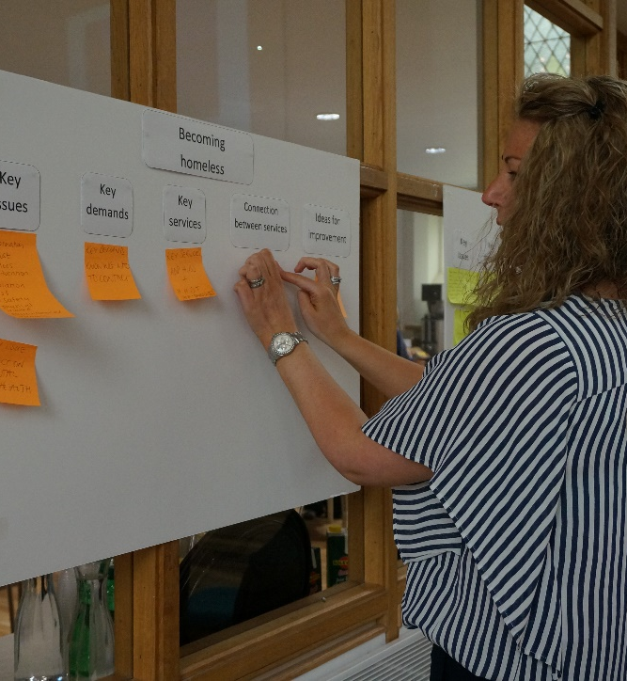
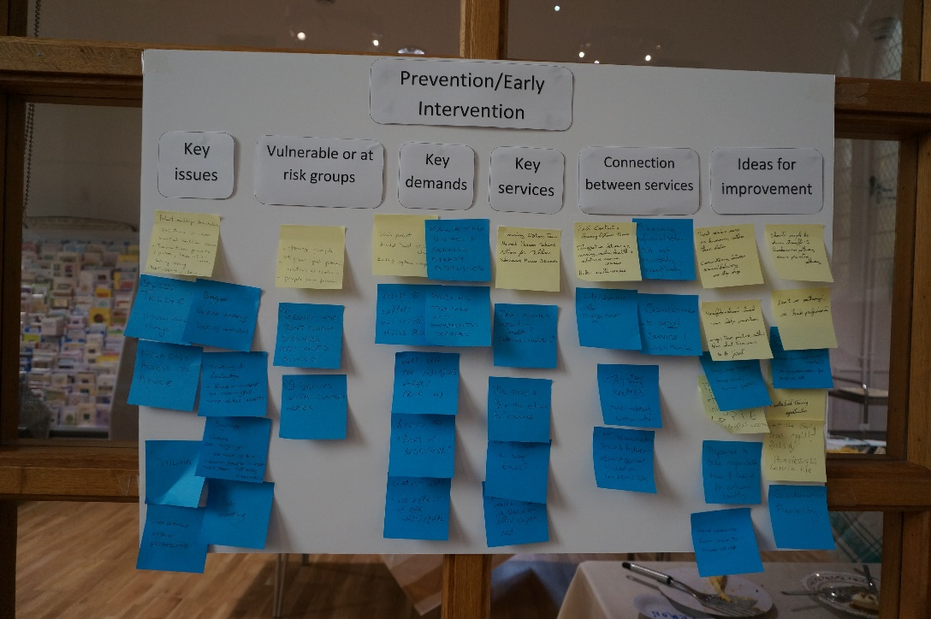
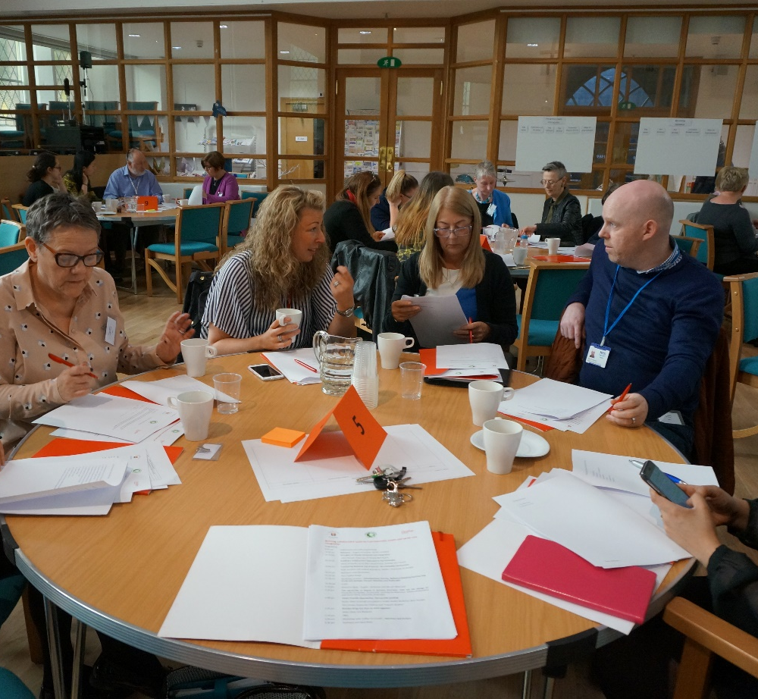
Participatory methodology

Slide 18

Dundee City Council’s Joint Commissioning for Homelessness
Since 2015 Smile4life has a representative in the Joint Commissioning for Homelessness at Dundee City Council.

Slide 19
Services in Dundee

Slide 20
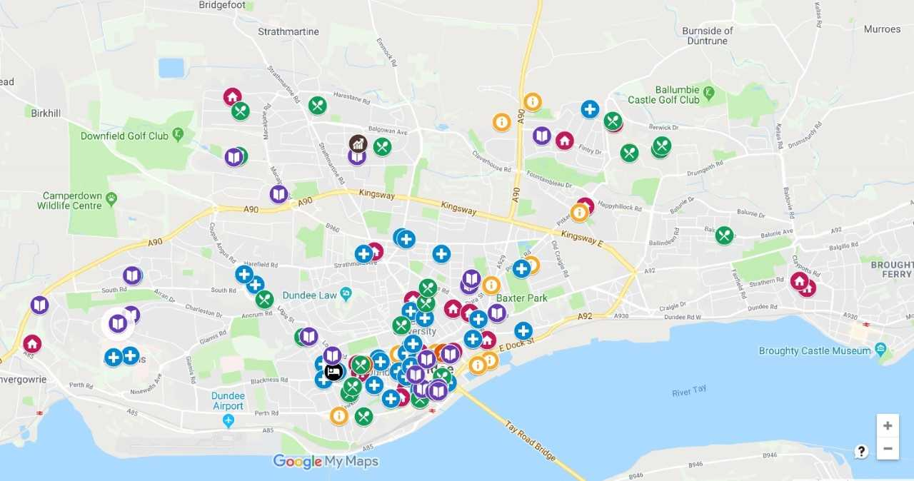
Spatial Distribution of Services

Slide 21
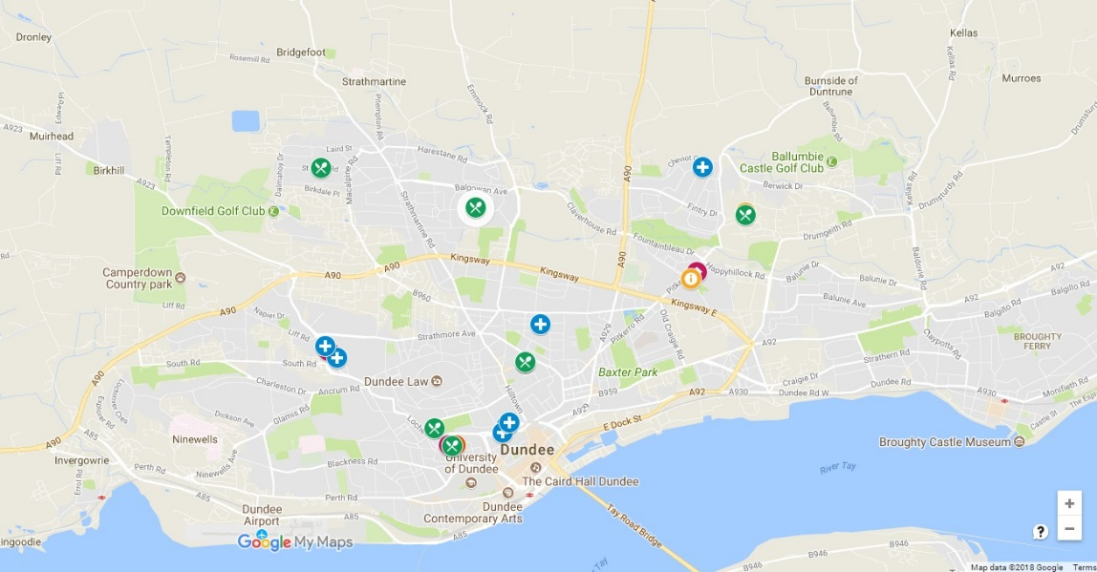
Services in the 5% most deprived areas (SIMD)

Slide 22
Final Comments
More integration and coordinated access to services
Continuous work on updating information
More equal distribution
More investment in services addressing prevention and sustainability
Service providing more than one support
Barrier to access and to engage – Stigma
Investment to strength a culture of collaboration

Slide 23

Andrea Rodriguez: a.rodriguez@dundee.ac.uk

