Slide 1
Protecting Rights, Restoring Respect and Strengthening Relationships:
A European Model of Restorative Justice with Children and Young People
Tim Chapman
Ulster University and European Forum for Restorative Justice

Slide 2
European Forum for Restorative Justice
Membership organisation
Network of practitioners, researchers and policy makers throughout Europe and beyond
Raising public awareness, influencing policy and improving research and practice
Source of expertise and support

Slide 3



EUROPEAN RESEARCH ON
A European Model on Restorative Justice with Children and Young People’

Slide 4
1st Research team – in charge of the analysis of the European context and national backgrounds
Prof. Dr. Frieder Dünkel, Criminology Professor, University of Greifswald, President-Elect of the ESC.
Andrea Parosanu, Legal Expert on Mediation, University of Greifswald, Germany and
Philip Horsfield, Research Assistant at Department of Criminology, University of Greifswald
2nd Research team- in charge of identifying the features of European best practices and designing a toolkit for their effective implementation
Tim Chapman, Course Director of the Restorative Practices Masters at Ulster University, Board European Forum For Restorative Justice.
Maija Gellin, Programme Director of Mediation in Education, Finnish Forum for Mediation
Monique Anderson, Academic expert in restorative Justice and Victimology, Leuven Institute of Criminology and Ivo Aersten, Head of the Leuven Institute of Criminology, Catholic University of Leuven

Slide 5
European overview
Every European country has some form of RJ
Very different motivations
Very different levels of implementation
Often patchy within countries
Low level crime
Not much empirical research

Slide 6
1. Assessment of Restorative Justice and rigorous selection of effective practices in Europe
Carry out in-depth research for the 28 national snapshots, capturing the situation of restorative justice in each EU Member State
2. Conduct study visits in three EU Member States
Belgium, Northern Ireland and Finland were selected as case studies by reason of their promising practices. The research team conducted field visits, focus group and interviews in all three countries.
3. Development and design of an evidence-based “European Model for Restorative Justice with Children and Young People.”
a. Outline a conceptual and theoretical framework distinctive to the
European context
b. Outline the European and international policy framework
c. Identify lessons learned from the three case studies
d. Literature review into the key features of effectiveness in the policy
and practices of restorative justice

Slide 7
Case studies
Finland – penal mediation for young people and adults plus strong presence in schools > social pedagogy
Belgium – penal mediation for young people and adults. Law recognises restorative conferences but under-used > high commitment to well-being of children
Northern Ireland – RJ mandatory in youth justice, very patchy for adults, strong community based restorative justice sector
Law in Northern Ireland leads to higher uptake and greater victim participation

Slide 8
Youth Conferences in Northern Ireland

Slide 9
Youth Conferences: the law
Criminal Justice (Northern Ireland) Act 2002
Mainstream within the youth justice system
Under 18 year old children and young people who admit to a criminal offence.
All offences other than those with a mandatory sentence
Prosecution referred or
Youth court referred
Voluntary
Offenders and victims decide
Youth Justice Agency staff facilitate the conferences and provide the prosecutor or court with a full report.
Conference agreements ratified by Prosecution Service or Youth Court

Slide 10
The Balanced Model
Community
Harm
Person responsible for harm
Injured party

Slide 11
Outcomes for Youth Conferences
Number of youth conferences now over 18,000
Over 90,000 people have participated in a youth conference
Victim participation; 50/70%
Victim and young person satisfaction; 90%+
26% serious or very serious offences, 53% intermediate offences but offending persistent, 21% minor offences but persistent offending.
94% successful completion of plans
Reoffending 43% (22% for serious harm)
Reoffending for all other community disposals 61%; for custody 72%
Reoffending for diversionary referrals 19%. Therefore early intervention highly effective
England and Wales put about twice as many young people into custody as Northern Ireland

Slide 12
Attrition
Offender responsibility
Victim vulnerability
Victim reluctance

Slide 13
However
Olivia Barnes research
Lack of preparation
Uncertain consent
Lack of active support
Intimidation (a room full of adults), shaming and coercion on action plan
Pressure to apologise
Lack of a voice for young people
Tariff set by Prosecution Service
Assimilation and colonisation rather than accommodation by the criminal jstice system – “McDonaldisation”
The critical importance of quality and in-depth training

Slide 14
Why a European Model?

Slide 15

?

Slide 16
Why a European Model/discourse?
To support governments, organisations, practitioners, trainers and researchers to develop restorative justice throughout society
Fit for societies which are modern, democratic, diverse and complex.
Policy context
– European Union Directives e.g Agenda for the Rights of the
Child, Charter of Fundamental Rights, Support and Protection of
Victims,
- Council of Europe recommendations e.g. Child Friendly Justice
Theoretical context – European critical social theory
Practice context – mediation and social pedagogy

Slide 17
International, EU and Council of Europe policy
The Council of Europe’s Recommendation (99)19 concerning Mediation in Penal Matters;
The Council of Europe Recommendation (2003) 20 concerning new ways of dealing with juvenile offenders and the role of juvenile justice;
The Recommendation (2008)11 of the Council of Europe on the Rules for Juvenile Offenders subject to sanctions or Measures.
The Council of Europe (2010) Guidelines on Child-Friendly Justice;
The Lisbon Treaty, which formally includes the Charter of Fundamental Rights of the European Union;
The EU Agenda for the Rights of the Child;
The European Commission’s first part of its study on Children in Judicial Proceedings (2014);
The Special Representative of the UN Secretary General (SRSG) on Violence against Children document, Promoting Restorative Justice for Children (2013);
United Nations Convention on the Rights of the Child (CRC);
Directive 2012/29/EU Of The European Parliament And Of The Council of 25 October 2012 on establishing minimum standards on the rights, support and protection of victims of crime.

Slide 18
The aim of restorative justice is to restore justice
Restorative justice engages those most affected by an injustice in a process that restores what has been lost, damaged and violated by the harm that has resulted from the injustice.

Slide 19
Shklar, J. N., 1990. The Faces of Injustice
The distinction between
1 Doing Justice
2 Undoing injustice

Slide 20
Why Restorative Justice?

Slide 21
Immediate outcomes
A satisfactory plan to address the harm agreed by all parties
The plan is completed in full
= Justice

Slide 22
What reasons should a young person have to avoid harming others?

Slide 23
I want to avoid punishment?
I cannot harm others because adults control me?
I am rewarded for good behaviour?
OR
It is the right thing to do - to respect other people’s rights and what they value.

Slide 24
Medium term outcomes
Recovery of the harmed person
Reintegration of the person responsible for the harm
= Life back in control

Slide 25
How will we raise children so that they may flourish in the Europe of the future?

Slide 26
Long term outcomes
The socialisation of empowered citizens
Social cohesion and inclusion
Culture of respect
= Good society

Slide 27
A harmful incident is an opportunity for learning how to live with others.

Slide 28
To learn to take responsibility for the consequences of actions.
To learn to respect people’s rights, culture, feelings, and needs.
To learn how to live in relationship with people in a diverse society.

Slide 29
What sort of society do we want for our children?

Slide 30
A culture of rights protecting people from harm and enabling them to participate actively in democratic government and an active civil society
Relationships that are just, respectful, and truthful
Positive socialisation processes

Slide 31
When and where?

Slide 32
Whenever and wherever adults engage with children.
Strengthening Families
Building Communities
Supporting Schools to Sustain Positive Learning Environments
Enhancing Criminal Justice

Slide 33
How?
Not one size fits all

Slide 34
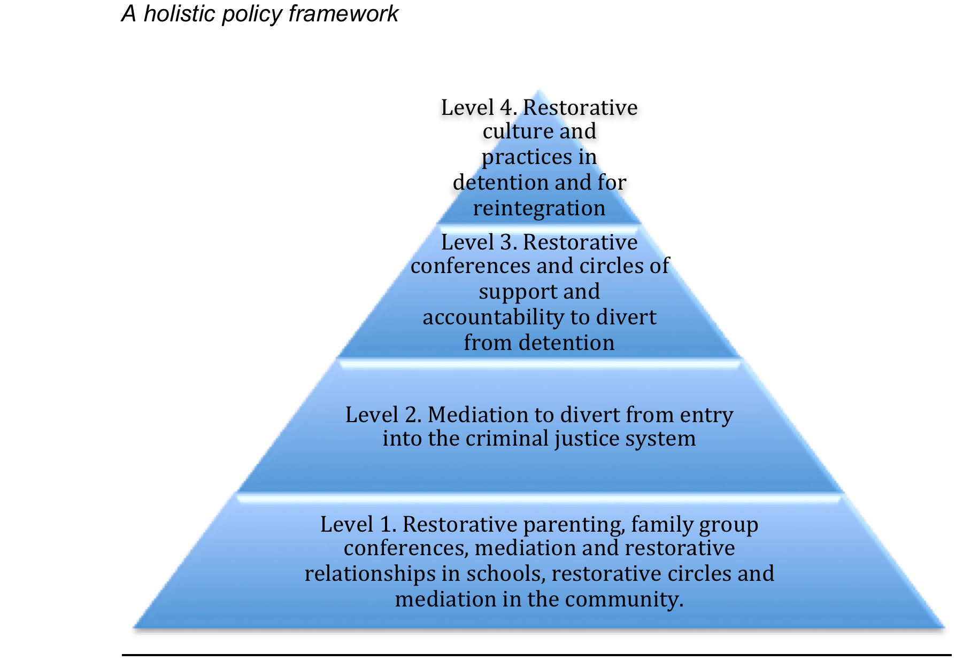

Slide 35
Community based Restorative Justice
ALTERNATIVE research
Inter-group conflict
Gangs
Hate crime
Disengagement from violent extremism

Slide 36
5. Toolkit for Professionals: Implementing a European Model for Restorative Justice with
Children and Young People (Vol III)
TOOLKIT’S STRUCTURE
Policy Guidelines
Analyses how legislation; policies on family support; policy on schools; training and overall coordination of the holistic policy framework can favour effective implementation of RJ, and how to measure effectiveness.
2. Guidelines for Schools
Tackles the functioning of restorative methods within schools, how the school administration , children and parents all can engage in these processes, and how they can be beneficial to learning goals.
3. Guidelines for the Criminal Justice System
Investigates which approach to the integration of RJ in the criminal justice system makes it accessible and efficient.
4. Guidelines for Practitioners
Addresses the specific role of the facilitator and it also addresses the specific process of different RJ measures, how and when people interact and with which objective.
5. Checklist for Action

Slide 37
Access the Model at http://www.ejjc.org/eumodel

Slide 38

People, even more than things, have to be restored, renewed, revived, reclaimed, and redeemed; never throw out anyone.

Slide 39
Thanks
tj.chapman@ulster.ac.uk

Slide 40


Coming soon . . .
Special issue of SJM on
restorative justice
out in April!

