Slide 1
Tackling poverty in Scotland – the business of schools?
Poverty, Attainment and Wellbeing - Seminar 1
Sara Spencer

Slide 2
COST OF THE SCHOOL DAY
Working with school communities to understand where difficulties lie for children and families on low incomes
Helping schools and local authorities to take action which will support children and young people’s participation and wellbeing and support families on low incomes.
Resources for schools
Advice, support and training to develop Cost of the School Day approaches
Practice gathering and sharing
Cost of the School Day activity now in most local authorities

Slide 3
TODAY
Drivers for schools to tackle poverty
What poverty in schools looks like – how low income affects children and young people’s wellbeing and participation
What tackling poverty in school looks like – how schools are making a difference to children and families on low incomes
BUT schools can’t tackle poverty on their own.

Slide 4
https://www.youtube.com/watch?v=5k94SlYzMzk&index=2&list=PLdtTilZi8S7-2rwi9LMw4JS0-3rALa7jW&t=1s

Slide 5
THE BUSINESS OF SCHOOLS?
The poverty in the poverty related attainment gap - ‘giving every child the same chance to succeed’
How Good is Our School – ‘staff have a shared understanding of child poverty… aware of the factors causing child poverty… work to minimise the effects of poverty on our children…’
Getting it Right for Every Child
GTCS Professional Standards – ‘acknowledging their social and economic context… taking into consideration barriers to learning… promote and support the cognitive, emotional, social and physical wellbeing of all learners.’
They are doing it every day and have always done it.

Slide 6
COST BARRIERS TO LEARNING AND PARTICIPATION
Travel
“Sometimes we get phone calls - not every single week, but occasionally - to say that they've not been at school because they've no money for bus fare.” (Staff)
“See, it's the bus. It stays for five minutes, and if you've missed it, you're screwed… [to stay for supported study] you either need to walk it home, or you need to pay extra for the bus.” (S6)
Learning
“I didnae want to pay 50 pence on Home Eccies. I didn't want to pay that because I couldn't be bothered because then that takes money off my lunch money, and I was like, nah.” (S4)
“We have to pay for theatre tickets - seeing live performance is part of SQA courses.” (S5)
Homework
"I've got to go to the library because we don't have a computer at home and I've had to hand in homework late or rush it and it hasn't been the best because I've only been able to get there at lunch or break and sometimes I've got to skip lunch to make sure I get the work done.“ (S5)

Slide 7
COST BARRIERS TO LEARNING AND PARTICIPATION
School trips
“My mum felt guilty that I couldn't go… Why do we have costly trips then? It puts people under pressure and it makes people embarrassed and disappointed if they can't go.” (P7)
“If you can't afford it you're just sat there in your class on your own and do work while they go - Mr P says if you don't go you need to work.” (S4)
Fun events
“People stay off cause they don't have the money or they think their outfit is silly... or they just wear their uniform.” (P7)
“Sometimes you just have to sit in class if you don't have any money [for a book fair], that’s happened to me - you get made fun of.” (P6)
School clubs
“There are children who have not participated in anything because there is a cost to it.” (Staff)
“We used to get told we had to bring… old trainers to wear on the pitch. But everyone didn't have trainers.” (P7)

Slide 8
SHAME AND STIGMA
Friendships
“A lot of people, I think, that have maybe got a lower income, round about the school, seem to be isolated and they've no got a lot of friends.” (S4)
Uniform
“Shoes and bags, that’s one of the biggest things. There’s some people you get that are nasty and pure heavy cheeky.” (S4)
“Some people get paid monthly and cannae even get new shoes until next month, but they expect it the next day.” (S4)
School trips
“I think my grandad put some in, and my mum put some in, and the school put the rest in. And they were alright about that but then I still felt like some of my teachers were looking down on me for that.” (S5)
Eating at school
“If your pals are going out at lunch you'll be a loner. It puts you out the group because they're going out and then you're sitting there on your own with a free meal.” (S3)
Learning
“Children have the embarrassment of us saying 'do you have your money? You can't cook today‘” (HE Teacher)
Notes:
Add resignation to situation

Slide 9
A parent’s perspective on school costs
“I struggle to keep up with these charges on what seems a non stop basis. The letters don’t say you are not obliged to pay, they only state the charge and have a reply slip at bottom for you. They think I can pay.
I struggle putting food on the table for both of us and pay my bills and try to get Christmas in so I go without food a lot of the time and I’ve lost weight these last few months. I’m angry that I’m being asked for so much money all the time. I’ve already had to stop her swimming lessons at the weekend. I have nothing more I can cut back on.
I would find it too embarrassing for other parents to know I can’t afford it and also I don’t want my daughter labelled in any way so I go without food so that I can pay these constant charges. Are schools allowed to charge so often?
Life is already hard enough without school making it even harder and risking kids being labelled or bullied because their parents can’t afford to keep up.”

Slide 10
"Children who are unable to participate in the same activities as their peers will very often not feel included and this can have a negative impact on health and wellbeing. The key is finding possible solutions to ensure all children have the same opportunities."
(Primary Teacher)

Slide 12
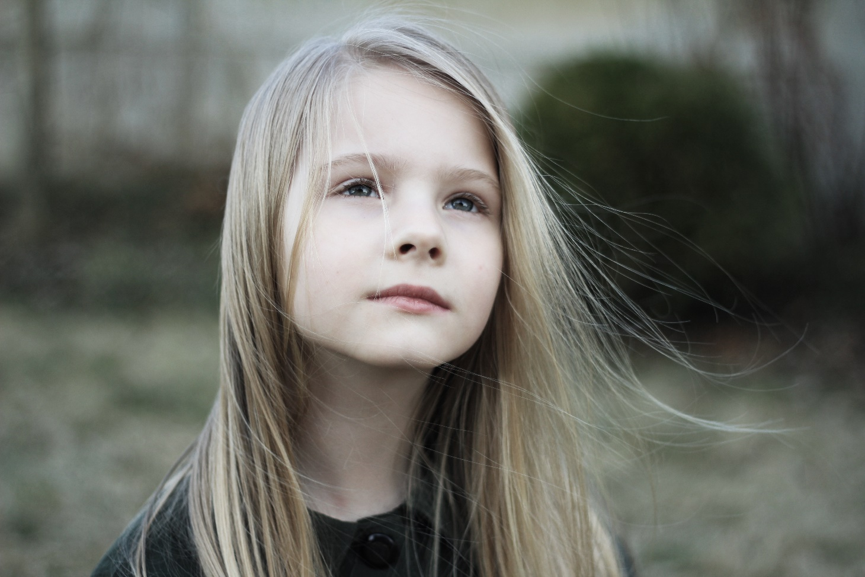
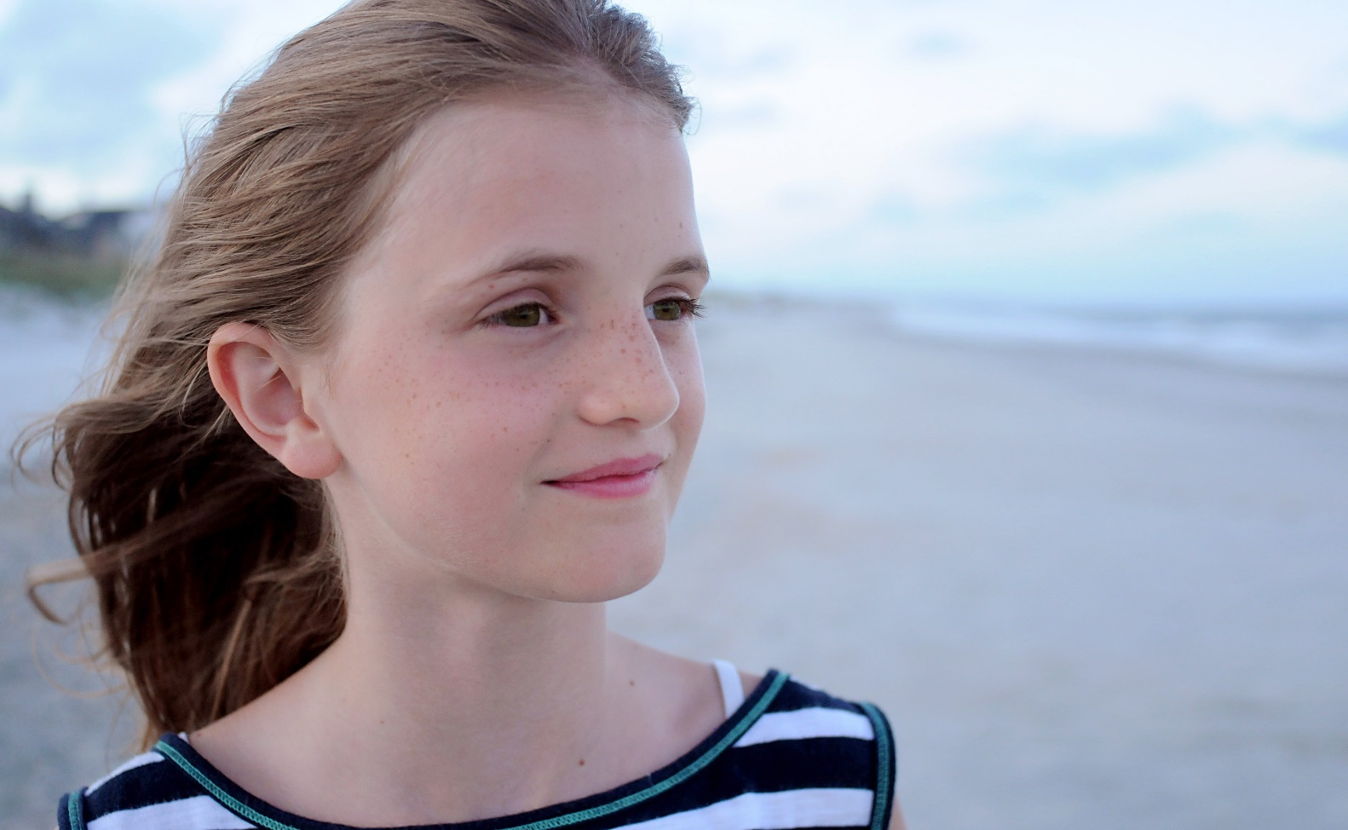
Lucy
Alison
Uniform often too small and grubby
Often without stationery and resources in class
Often no breakfast - family have lunch debt
Doesn’t take part in after school clubs
Won’t be going to her P7 residential
Doesn’t do homework when ICT or craft involved
Rarely attends fun school events
Decent uniform
Has resources she needs in class
Has breakfast and lunch every day at school
Loves Taekwondo and Scottish Country Dancing club
Looking forward to her P7 residential
Able to do all homework set
Usually attends fun school events

Slide 13
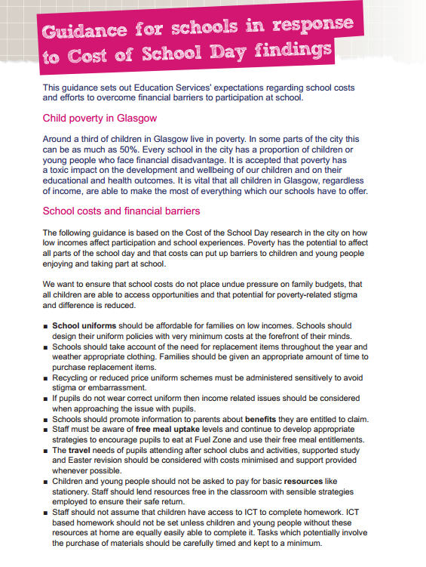
BUT IT’S NOT THE BUSINESS OF SCHOOLS ALONE
No child or young person in Dundee will start school without a breakfast
No child in Dundee will miss out on their Primary 7 residential trip due to cost
All schools will develop a Cost of the School Day action plan by the end of session 2018/2019
All children and young people in Dundee schools will have access to an affordable school uniform
“All subjects within the school curriculum should be offered with no charging and pupils should not make subject choices based on ability to pay.”
Head of Education, Dumfries and Galloway Council

Slide 14
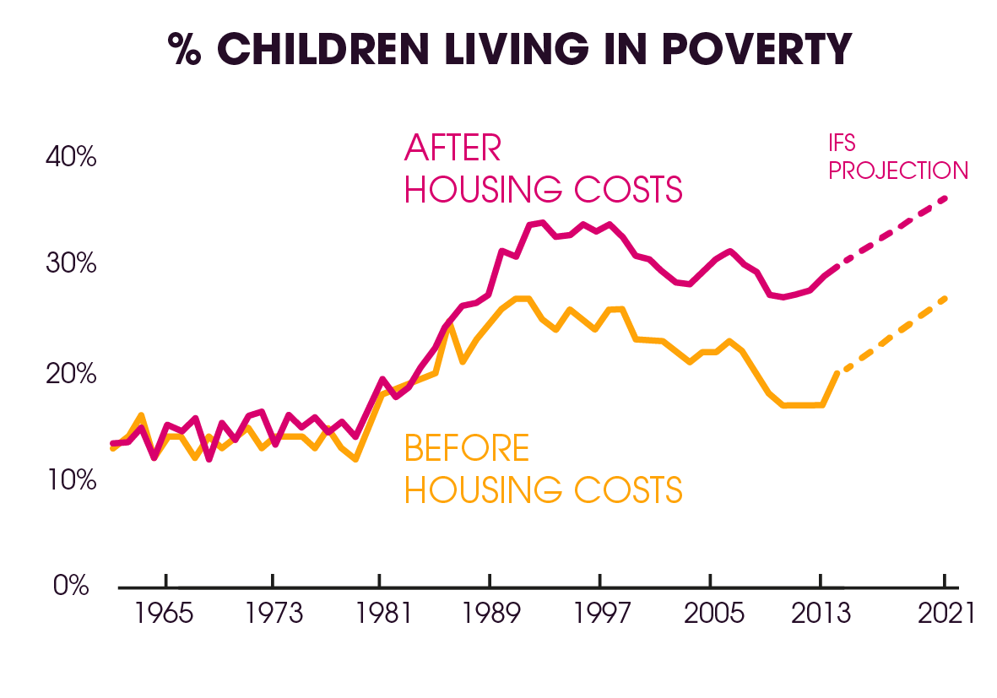
CONCLUSIONS
Tackling poverty is already the business of schools - countless examples of ways in which schools are helping to mitigate the effects of poverty and making a difference to children and families
Can’t do it on their own
Can’t do it without the right information and support and leadership
In coming years it’s even more crucial that we all, including schools, are tackling poverty.

Slide 15
Contact us sspencer@cpagscotland.org.uk
Resources and support www.cpag.org.uk/cost-school-day
Share what you’re doing with us and other schools across Scotland by completing the Cost of the School Day Practice Survey https://www.surveymonkey.co.uk/r/WTD3NDF
Sign up for Cost of the School Day eNews on our website
@CPAGScotland - #CostoftheSchoolDay

