Slide 1
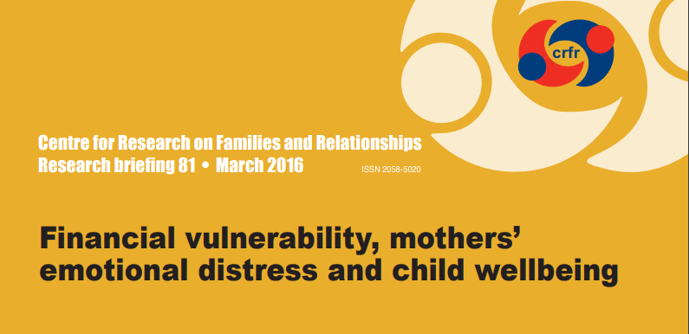
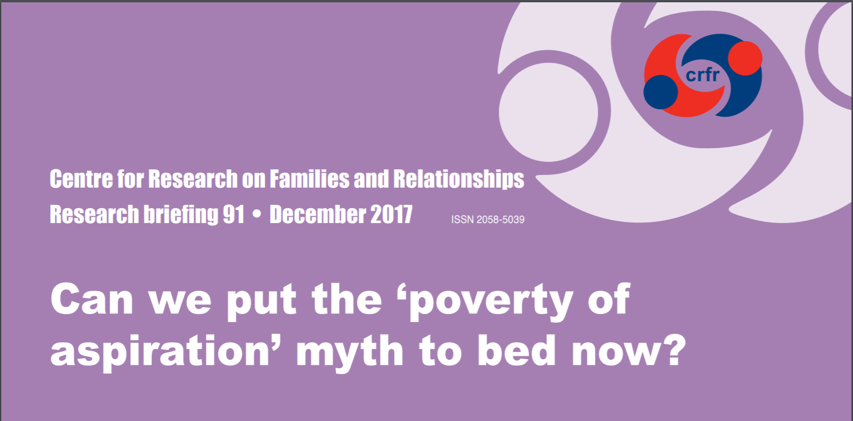
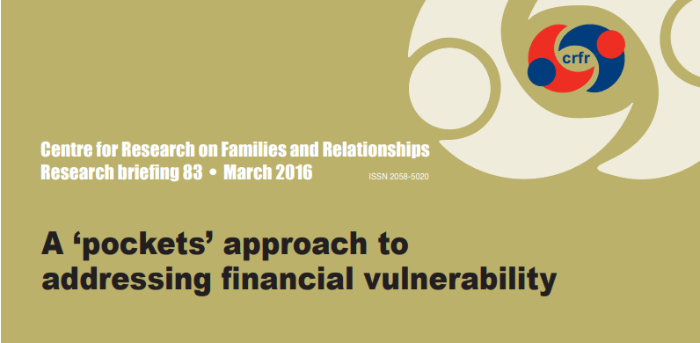
Poverty, attainment and wellbeing: making a difference to the lives of children and young people.
Tackling child poverty locally
Dr Morag Treanor
University of Stirling
SUII Seminar Series, Glasgow
22 October 2018

Slide 2
Outline
Confusing risks, causes and consequences
Welfare reform – who does it affect?
An illustration – the poverty premium
What’s different in Scotland
What can be done locally
Education
Income maximisation

Slide 3
Confusing risks, causes and consequences
What people (and UK govt) believes are causes of poverty:
Addiction (usually portrayed as drugs/alcohol)
Poor parenting
Being bad at relationships
Low educational attainment
Worklessness (what does that even mean?)
Debt
Personal characteristics and behaviours
If these were causes of poverty, then the poorest person in the UK would be…

Slide 4
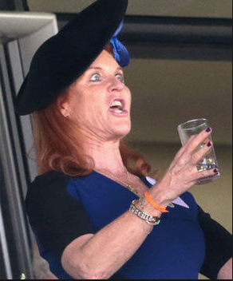
Poor Sarah…
“Had I not just chosen food as my friend, I would have chosen something else. I mean a lot of people turn to shopping, alcohol, smoking, any other addiction. My addiction was food.”
“I’m a hardworking single mum”.
“I’m continually on the verge of financial bankruptcy.”
"Do you understand that I absolutely have not a pot to piss in?“
“It’s just because my ex-husband’s so nice that he lets me be a guest at his house. If I didn’t have him I’d be homeless.”
"happiest divorced couple in the world".
Sarah, Duchess of York is left 'devastated' after being ditched by her toyboy lover Manuel Fernandez after two years together.
A university education might have helped her navigate her adult life with less drama, she says.
Sarah Ferguson, Duchess of York
Notes:
Sarah Ferguson was indebted to the tune of £5m in the mid 90s and £2m in 2011, paid off by her ex-husband Prince Andrew.
Divorced
Unemployed
Would be homeless if she were not housed on Andrew’s estate
Low level of education despite attending private boarding school
Addiction – food
The serious point I’m trying to make is that these five categories do not distinguish the poor from the non-poor. They do not measure poverty. Anyone at any level of income can experience these situations. A measure of poverty that doesn’t include income denies the real cause of poverty. While these can be a risk or cause of poverty, they are more likely to be a consequence of poverty. The current UK government continually mistakes cause and consequence.
Message number one: Don’t conflate poverty with difficult circumstances.

Slide 5
Risks, causes and consequences
These characteristics do not distinguish the poor from the non-poor
They do not measure poverty
Anyone at any level of income can experience these situations
These can pose a risk of poverty but it’s not inevitable
These are more likely to be consequences of poverty
Media, government and the general public confuse this
However, some of these characteristics, when combined with poverty, are especially devastating for children and need a targeted response, eg addiction (ACEs)
Notes:
These are more visible than poverty and what frontline workers, eg teachers and social workers, see in their work and mistake them either as poverty or as causes of poverty. Poverty can be quite invisible.
While these factors do not necessarily cause poverty, they do increase the risk of living in poverty. And when these situations combine with poverty, for example, addiction, the consequences for children and for child development are severe. That’s when good, dedicated, well-targeted services are required.

Slide 6
Why is it important to understand the difference?
How we understand the causes of poverty will determine how we define, measure and tackle it.
Eg - If a government decides that poverty is not about money then they will have the perfect reason not to give people in poverty more money.
The Coalition government (2010-2015) and the Conservative government (2015-present) changed the definition of poverty away from income.
Government policy is not neutral. How a government responds sets the tone.
We mustn’t be distracted by behavioural, individualised explanations of poverty.
If we do we will have the wrong response and try to change the wrong things.
Misunderstandings about poverty can:
present barriers to, and direct attention away from, action required to prevent and alleviate its effects.
Reduce public support for policies and interventions to prevent and alleviate it.
Cause stigma, blame, shame and lead to concealment.

Slide 7
2. Austerity and welfare reform – UK level
Couple families with dependent children in Scotland losing an average of more than £1,400 a year, and lone parent families around £1,800 a year.
Tax credits cuts (only a few):
Family element removed (April 2017 - losing up to £545)
Two child limit (April 2017 - losing up to £2,780 per child a year)
Reduction in income increase disregard (April 2017 £5,000 to £2,500)
Minimum hours worked (April 2012)
Childcare costs (April 2012)
Backdating (April 2012)
Universal credit – lots!
While 9 out of 10 families with children were eligible for tax credits in 2010, and 6 out of 10 in 2015, only 5 out of 10 families with children will be eligible for universal credit by the time it is fully rolled out.
Sanctions - benefit payments stopped for a minimum of four weeks and a maximum of three years.
http://www.cpag.org.uk/sites/default/files/CPAG-Scot-WR-impact-families%28May18%29.pdf

Slide 8
An illustration – the poverty premium
where people living in poverty cannot pay the full amount for an item, nor can they access mainstream credit, nor pay on a credit card, nor set up a direct debit and so have to pay a premium…
Illustrating the importance of income to poverty

Slide 9
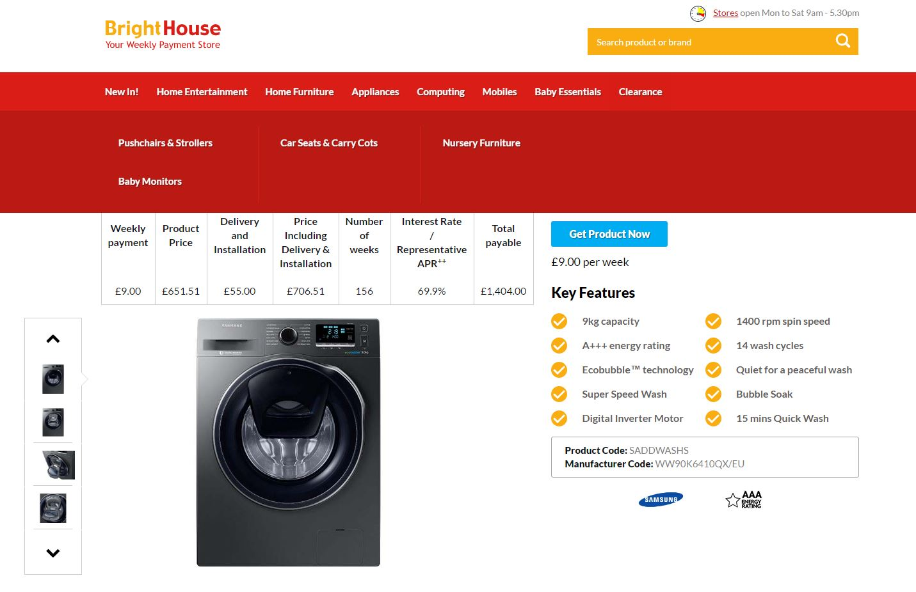
This was in April 2017
Notes:
Dundee story – compulsory insurance and extended warranty. I don’t know if insurance attracts interest as the website is utterly opaque.
Variable interest rates.
Dundee story of £3k washing machine.

Slide 10
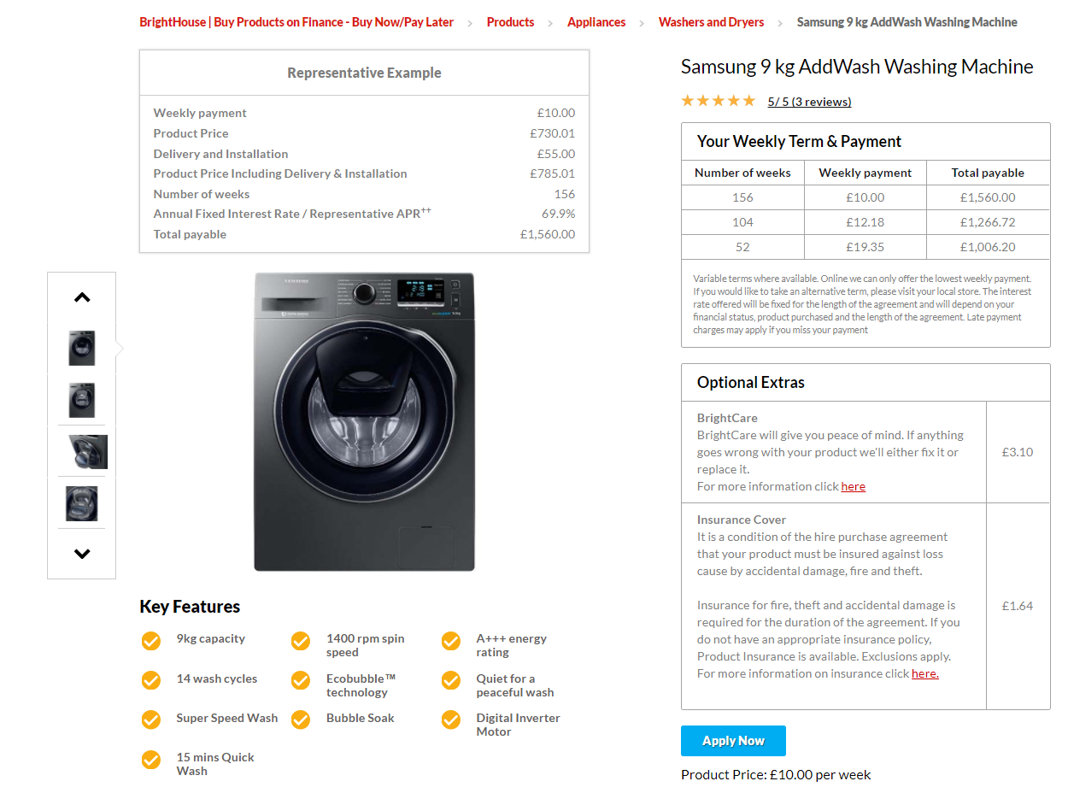
11% increase between April & August 2017
=£739.44
=£2299.44
Notes:
Brightcare and Insurance cover added. I didn’t realise that back in April 2017.
These are weekly costs over the whole period of financing.
The increase in cost is £156.

Slide 11
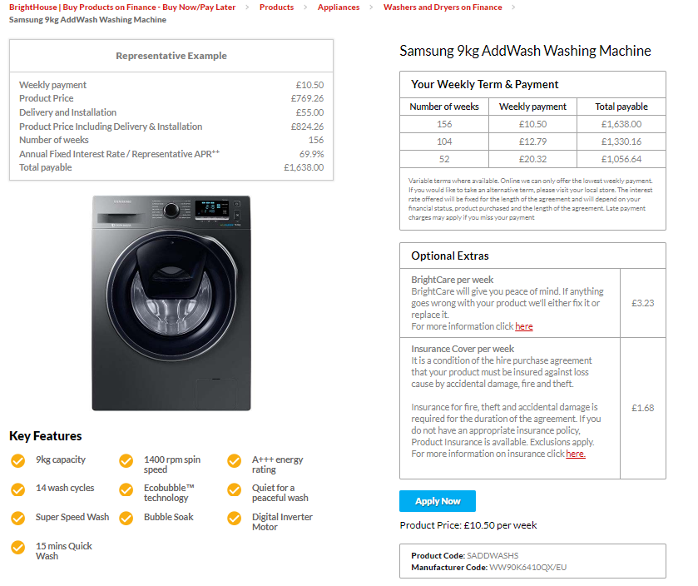
A further 5% increase between August 2017 & April 2018
=£765.96
=£2403.96
Notes:
The increase in cost is £78.
Or 16% increase in the cost alone in a year (April 2017 to April 2018).
And that isn’t looking at the optional extras which have also increased by 3.5% since August 2017 (not April).
Increases are always by £156 or £78 which lead to a £1 or £0.50 extra per week which won’t sound like a lot to people.

Slide 12
Notes:
This is the price of the same machine in Curry’s.

Slide 13
POOR FAMILIES ARE PAYING 10 TIMES MORE FOR A WASHING MACHINE THAN YOU OR I BECAUSE THEY CAN’T LAY THEIR HANDS ON £250.
Notes:
These are not even the cheapest washing machines in Curry’s. I sorted on the same capacity (9kg) and same rpm (1400).
If you wanted cheaper, the cheapest they have is around £160.

Slide 14
4. What’s different in Scotland

Slide 15
Child Poverty Act 2017 – Delivery Plans
The Act requires the Scottish Government to produce three Delivery Plans over the period to March 2031
In preparing a delivery plan, the Scottish Ministers must, in particular, consider what (if any) measures they ought to take in relation to—
the provision of financial support for children and parents
supporting local authorities to consider the automatic payment of benefits and support,
the provision and accessibility of information, advice and assistance to parents in relation to—
social security matters
income maximisation
financial support
education
the availability and affordability of housing
the availability and affordability of childcare
the facilitation of the employment and of the development of the skills of parents
physical and mental health
children living in lone-parent households
consulting, amongst others, such persons and organisations working with or representing parents.
A delivery plan must, in particular, set out whether, during the period of the plan for the purpose of meeting the child poverty targets, the Scottish Ministers intend to bring forward legislation to exercise the power provided for in section 24 of the Scotland Act 2016 (discretionary payments: top-up of reserved benefits)

Slide 16
First Child Poverty Delivery Plan
Published 29th March 2018:
Commitment to introduce an income supplement to help boost family finances
Minimum payment for the School Clothing Grant of £100 for all LAs
£1 million on food insecurity during school holidays
New support for childcare after school and in the holidays.
Financial Health Check service
Grow the affordable credit sector
A new Best Start Grant.
Employment support for parents
Tackling low pay
Workplace equality and gender pay gap
Help with fuel poverty and housing costs
Help on income maximisation and the poverty premium
http://www.gov.scot/Resource/0053/00533606.pdf
Notes:
Income maximisation is one of the few poverty reduction strategies that affects children and families pre-, per- and post-pregnancy.
Including income maximisation allows CPPs to identify those at risk of poverty and to take preventative action, as well as to mitigate against already existing poverty
Income is brought into the local area and spent locally.

Slide 17
5. What can be done locally
Education
Income maximisation:
Healthier Wealthier Children
Financial Inclusion & Capability Service
Best Start Grants

Slide 18
Education – where does the problem lie?
Cost of the school day
Poverty of aspirations myth
Barriers to parental engagement:
Self esteem/self efficacy
Previous experiences of school (contradictory)
Gender issue – parent or mother?
School culture
Pressures on teachers’ time
Teacher (mis)understandings
Notes:
Teacher understanding – teachers do conflate the combination of adverse circumstances and poverty with poverty itself. Adverse circumstances are visible, poverty less so. This is understandable – without education on the causes and consequences of poverty, teachers will not know any better.
Pressures on teachers’ time, especially in schools with high levels of deprivation. Where young people do experience multiple deprivations or adverse circumstances teachers often spend time on work that is more akin to social work than teaching. There needs to be resources in place to target those children experiencing multiple adverse circumstances in addition to poverty to free teachers’ time for teaching.

Slide 19
School costs - what can you do?
Encourage take up of free school meals/school clothing grant/EMA entitlement
Ensure privacy for pupils on free school meals in order to minimise stigma.
Make taking school meals the usual mode of eating at lunchtime.
Accept supermarket uniforms rather than branded school uniforms
Reduce fundraising/charitable giving that can highlight poorer pupils’ lack of income, e.g. money for book clubs, wear your own clothes day.
Schools can consider an end of year activity that is of minimal cost to parents, rather than school proms which can be expensive for parents.
Implement breakfast and holiday clubs on a sliding scale of fees that are available to all pupils, but free to those on the lowest incomes.
Provide teachers with high quality continuing professional development on the nature, causes and consequences of poverty, such as the recent initiative by the City of Edinburgh Council’s 1 in 5 project.
Undertake initiatives to build relationships with the poorest parents so that they are comfortable to be in the school environment.
Become a Rights Respecting School? See Aberdeen City Council’s experience

Slide 21
Poverty of aspirations
Aspirations have become a key educational policy driver in the UK and are seen as one of the critical levers for improving educational attainment and raising skills.
children and their parents are seen as lacking ambition
leads to a deficit view of aspirations, holding young people and their parents ‘responsible’ for their ‘lack of’ ambition.
but aspirations expressed by young people and their parents reflect the expectations and constraints inherent within their setting, rather than a free choice of desired outcome. (Ralf St Clair & Amanda Benjamin (2011) Performing desires: the dilemma of aspirations and educational attainment, British Educational Research Journal, 37:3, 501-517)

Slide 22
Teachers and the poverty of aspiration
Teachers and student teachers often found to have little understanding of the link between child poverty and educational attainment, which lead to their falling back on negative stereotypes of children and parents living in poverty (Thompson et al, 2016: 220).
Often teachers do not understand enough about existential poverty to get beyond a pathologising discourse of families, parents and children as feckless and undeserving (Singh et al. 2013)
Negative stereotypes about impoverished children based on deficit assumptions can perpetuate inequality (Cummings et al., 2012).

Slide 23
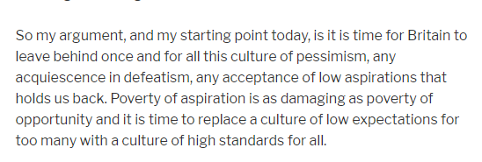
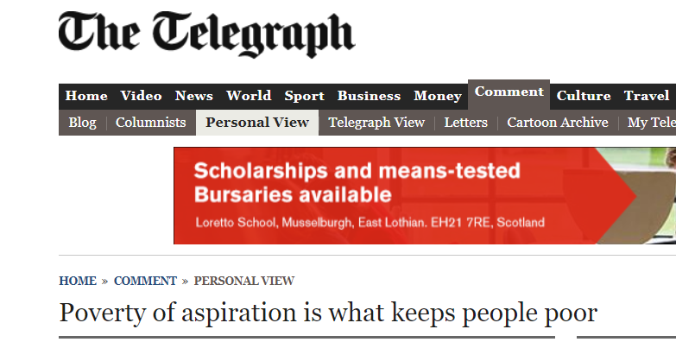
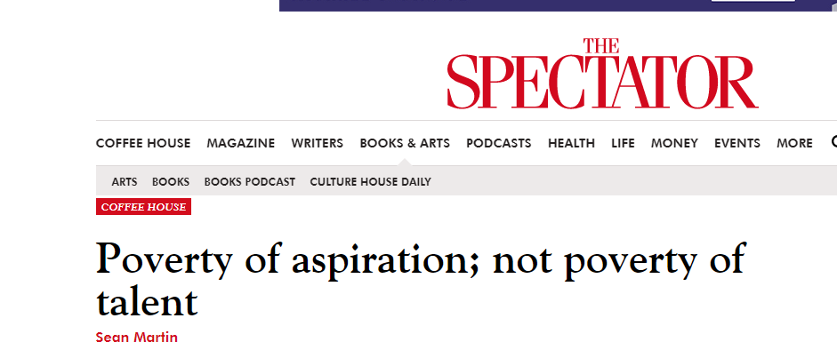
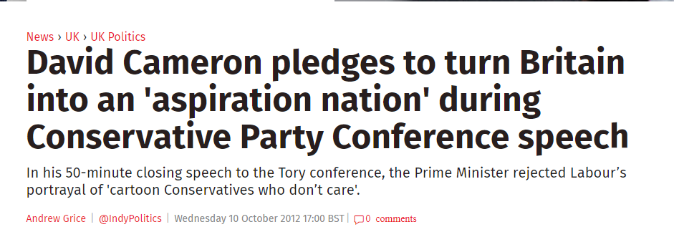
GORDON BROWN
THERESA MAY
TONY BLAIR

Slide 24
Despite excellent work on child poverty by the Scottish Government, myths persist…
Alex Cole-Hamilton (LD)
Michelle Ballantyne (C)
Ruth Maguire (SNP)
Scottish Parliament 8 November 2017. Official report of the Stage 3 debate on the Child Poverty (Scotland) Bill [Online]. Edinburgh: Scottish Parliament. Available: http://www.parliament.scot/parliamentarybusiness/report.aspx?r=11177&i=101890 [Accessed 6 December 2017].

Slide 25
Notes:
Of the four statements that children responded to there were no differences by the four categories of poverty over time.
This means that children at this age (7/8 years old) do not experience different enjoyment of school based on their socioeconomic background.
That is not to say that their ability to participate fully in school, or their ability to make equal use of what is available to them, or indeed their response to or conduct in school will be the same.
Rather it shows that in spite of differences perceived by teachers or felt by children in the classroom, children in poverty value school as much as their better off peers.

Slide 26
Notes:
There are differences in the types of aspirations parents hold for their children according to their experience of poverty.
However, there is no ‘lack’ of aspiration per se.
Parents living in any type of poverty are 1.6 times more likely to want their child to start a training course or undertake an apprenticeship on leaving school.
Parents living in any type of poverty are more likely to want their child to leave school to go onto further education college.
Parents living in any type of poverty are approximately half as likely to want their child to stay on at school beyond age 16.
This corresponds to the literature that poorer parents are more likely to aspire to apprenticeships/training/further education and less likely to aspire to higher education for their children.
Parents’ aspirations differ by poverty experience, but they are still ‘high’ aspirations, and are a construct of parents’ own knowledge, understanding and experience.

Slide 27
Take home messages
The problem with the ‘poverty of aspiration’ as a concept is not only that the research evidence does not support it, but also that it passes the responsibility for a presumed lack of aspirations onto parents and children.
In so doing it shifts responsibility away from local and central government, and schools, to children and parents from low socioeconomic backgrounds.
Teachers are also disadvantaged by not understanding the causes of poverty, its effects on children and on their education, and by believing that the poverty of aspirations is a fact.
Teachers perpetuate the myth but are tasked with solving the problem as it is (wrongly) understood.
School is important to and for poorer children.
Poorer parents value school and want to help – all parents want the best for their child
Poorer parents less likely to know what that looks like or how to achieve it
Poorer parents less likely to know how to help their child

Slide 29
Income maximisation
The evidence shows negative effects of financial insecurity on maternal and child wellbeing over and above the negative effects of income and poverty
One of the Scottish Government’s foci is ‘Pockets’ (income maximisation) – work in this area would be in synergy with national priorities
Opportunities for sharing of learning and resources to develop income maximisation services
Income maximisation is one of the few poverty reduction strategies that affects children and families pre-, per- and post-pregnancy.
Including income maximisation allows local bodies to identify those at risk of poverty and to take preventative action, as well as to mitigate against already existing poverty
Income is brought into the local area and spent locally.

Slide 30
Health example - Healthier Wealthier Children

Slide 31
Healthier Wealthier Children
The following slides were taken from What Works Scotland with the Glasgow Centre for Population Health:
http://whatworksscotland.ac.uk/wp-content/uploads/2017/09/HWC-outcomes1.pdf

Slide 32
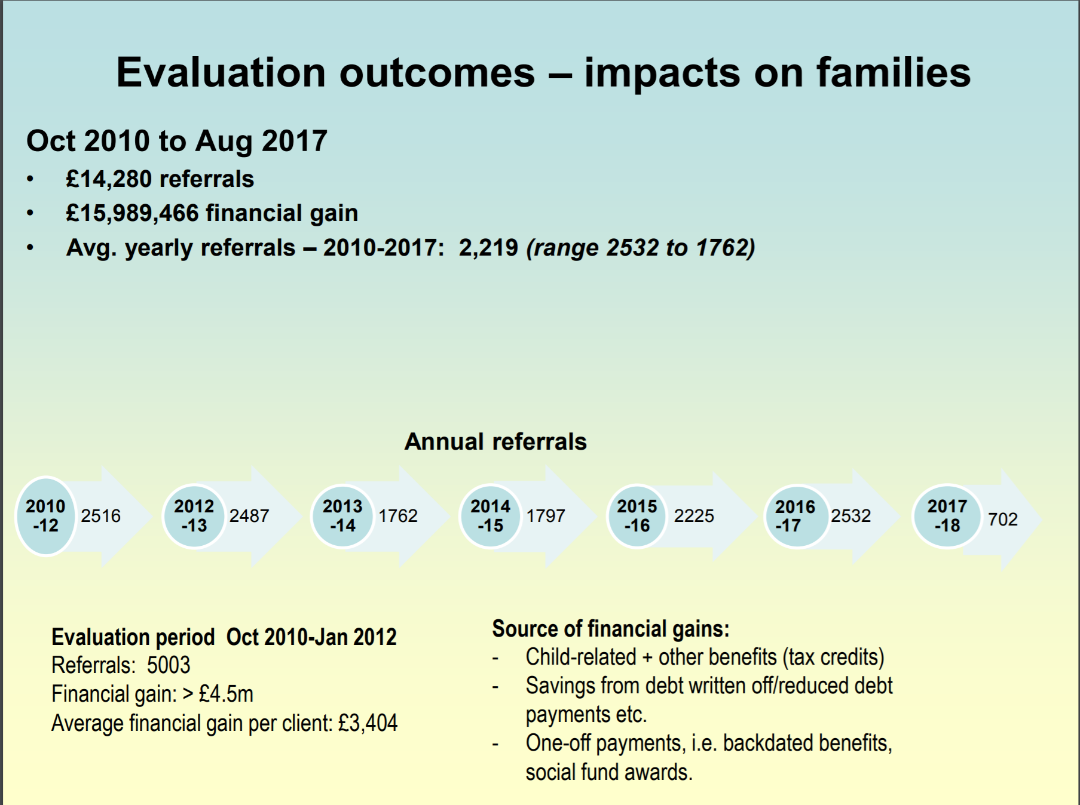

Slide 34
Income maximisation in schools
Notes:
New Family Support & Advice Service
CHAI Advice is coming to your local School!
CHAI are now providing free, impartial and confidential advice directly to families across Edinburgh whose children attend the following schools –
Tynecastle High School
Dalry Primary School
Stenhouse Primary School
Pilrig Park School
Rowanfield School
The appointments are based within each school to make the service more accessible for parents/ guardians who may be struggling with:
Housing Issues
Debt Problems
Income Maximisation
Welfare Rights

Slide 35
New in Scotland - Best Start Grant
Current:
SSMG = £500
(First child only)
Total (2 kids) = £500
From 2019 (now Dec 2018)
BSG (first child) = £600
BSG (subs children) = £300
Payment at nursery = £250
Payment at P1 = £250
Total (2 kids) = £1900

Slide 36
What can you do?
There’s much that you can do:
Understand what the real causes of poverty are and what results from it
Understand that welfare reform adversely affects family income
Understand that people mask their poverty out of shame or fear of unwanted service intervention
Address impacts of poverty on children’s schooling
Build relationships based on dignity, equity and respect
Know who you can refer on to
Refer for money advice and maximisation
Financial Inclusion & Capability Service
Provide training in ITE and as CPD on poverty and education

Slide 38
Last words: Who knows what document this is from?
‘The Group are concerned that the attitude of professionals and planners for children appears to be influenced by dated personal theory and prejudice. The end result of this process is that policy and professional action evolve in some mysterious fashion because there is no agreed view on basic child care needs and objectives…
…The Group hopes to improve policy development for children by stimulating debate and discussion, culminating in a minimum declared charter of rights for all children in …’

Slide 39
Room to Grow
Strathclyde Regional Council (1979)

