Slide 1








Housing and Ageing
Linking strategy to future delivery for Scotland 2030

Slide 2
Welcome
To plan for housing and ageing effectively for 2030, we have analysed shared policy challenges and priorities across the UK, to understand how they are being delivered and experienced by older people, and to take forward best practice.
We are mobilising learning from practitioners, stakeholders and policy makers in Scotland, England and Wales by developing and exchanging knowledge between diverse geographical areas that share similar issues around housing and ageing (e.g. inequalities around rural/urban/disadvantaged communities).
These events have brought together academics, policy makers, service users and organisations delivering policy objectives in practice.

Slide 3

Who are we?
Professor Judith Phillips, Deputy Principal (Research) and Professor of Gerontology
Dr Vikki McCall, Head of Housing
Dr Alasdair Rutherford, Senior Lecturer in Social Statistics
Dr Jane Robertson, Lecturer in Dementia Studies
Dr Melanie Lovatt, Lecturer in Sociology
Dr Ryan Woolrych, Associate Professor in Urban Studies
Professor Judith Sixsmith, Chair in Health Related Research

Slide 4

Jeremy Porteus, Managing Director, Housing Learning and Improvement Network
Zhan McIntyre, Public Affairs
Dr Friederike Ziegler, Researcher in Urban Planning and Ageing
Jim Eadie, Housing lead for Age Scotland

Slide 5
Our Strategic
Programme
Final Conference Event
Practitioner Working Group
Stakeholder Working Group
Policy-makers and Influencers Working Group
Co-designed, evidence-led set of recommendations for the UK, Scottish and Welsh Governments
An international network for Housing and Ageing

Slide 6
Our approach underpinning the programme
Ageing in the Right Place
Housing &Home
Community
Care & Technology
Place and Belonging
Underpinned by adventurous qualitative methodology

Slide 7
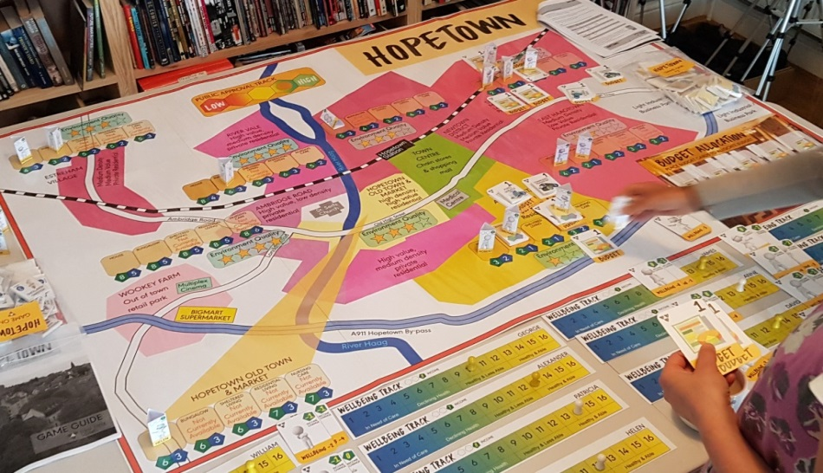
The ‘Serious Game’
A ‘Serious Game' - a bespoke, personalised, strategic exercise – was conducted to allow negotiation between potential obstacles for delivering Housing and Ageing strategies by 2030.
The game facilitated knowledge exchange by involving participants in taking on different perspectives within policy and practice, and managing different scenarios.

Slide 8


Today
We will be taking photos and tweeting about the event (please sign our form!) #housingandageing – if you do not wish to have your photo taken please let us know.

Slide 9
Todays agenda
09.30 | Registration and refreshments
10.00 | Welcome and outline of event Overview of three working groups | Dr Vikki McCall
10.15 | Coming together at the national level to exchange knowledge and make positive change | Professor Judith Phillips, Deputy Principal (Research) at University of Stirling
10.40 | Time for action in the housing sector – how do we implement change and make a difference? | Jim Strang, CIH Vice President & CEO of Parkhead Housing Association
11.00 | Comfort break
11.15 | The Serious Game methodology | Jim Wallman, Game designer
11.30 | What did we learn from the policy makers’ perspectives? | Dr Friederike Ziegler
11.45 | What did we learn from the stakeholder perspectives? | Dr Jane Robertson
12.00 | What did we learn from the developers’ perspectives? | Dr Ryan Woolrytch & Prof. Judith Sixsmith
12.15 | What did we learn from the service deliverer perspectives? | Dr Melanie Lovatt
12.30 | Lunch and networking
13.30 | Co-designing a set of recommendations for the UK, Scottish and Welsh Governments | Dr Vikki McCall
15.00 | Wrap up and conclusions | Dr Vikki McCall

