Slide 1




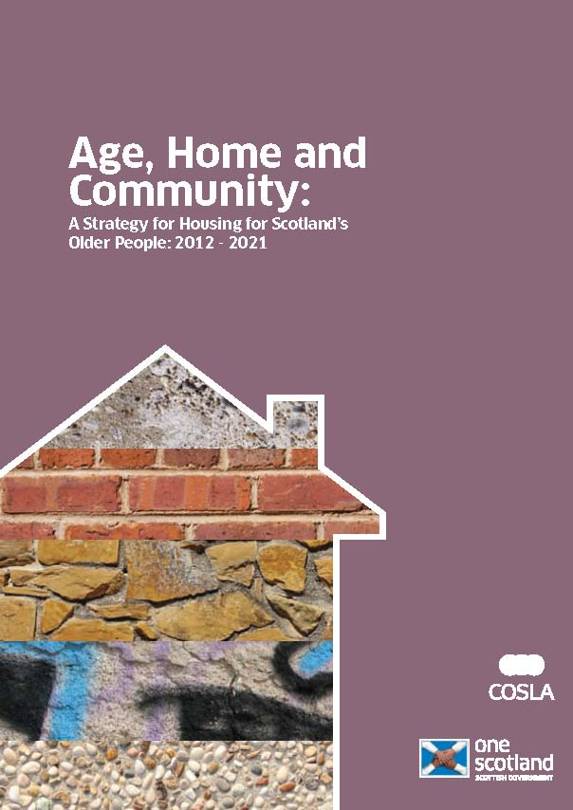



Coming together at the national level to exchange knowledge and make positive change
Professor Judith Phillips

Slide 2
How do we learn from each other?
Shared policy challenges and priorities in the UK

Slide 3
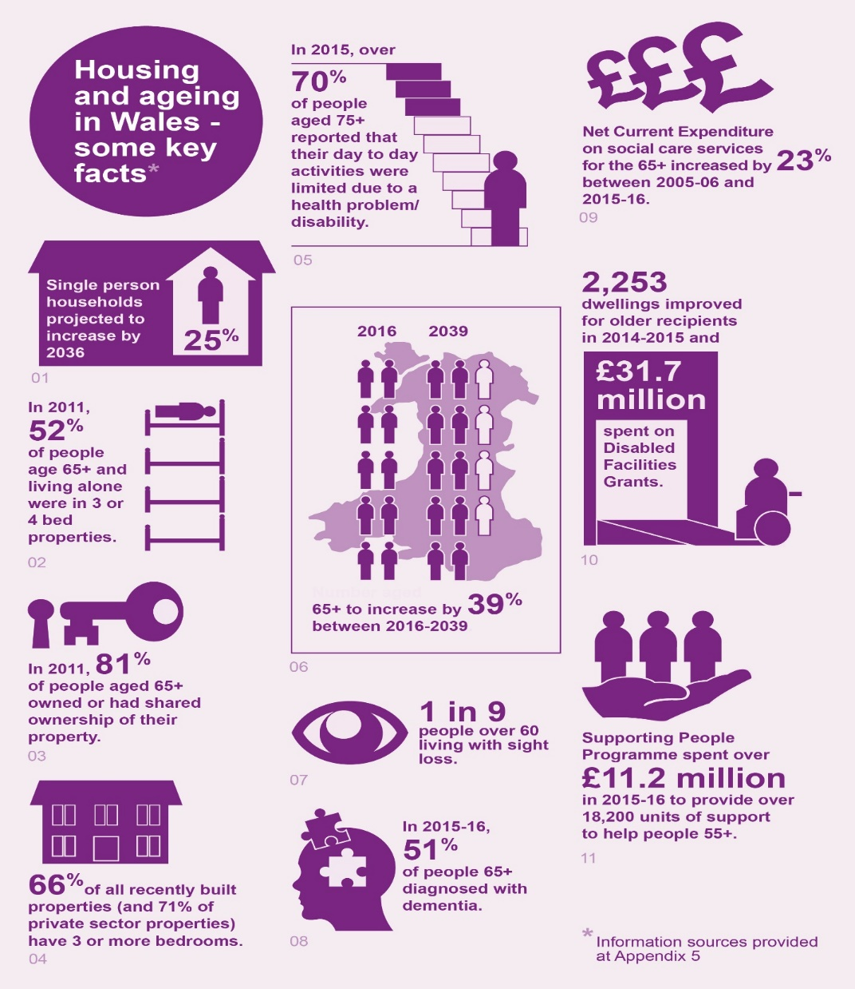
Context-shared policy challenges
Demographic - an ageing population; intergenerational equity
Policy - lack of suitable housing choices for later life; wider policy context
Economic - rising costs in all areas of housing and care; costs to NHS and social care; financing
Environmental - energy efficiency, fuel poverty
Social - isolation and loneliness, connected communities

Slide 4
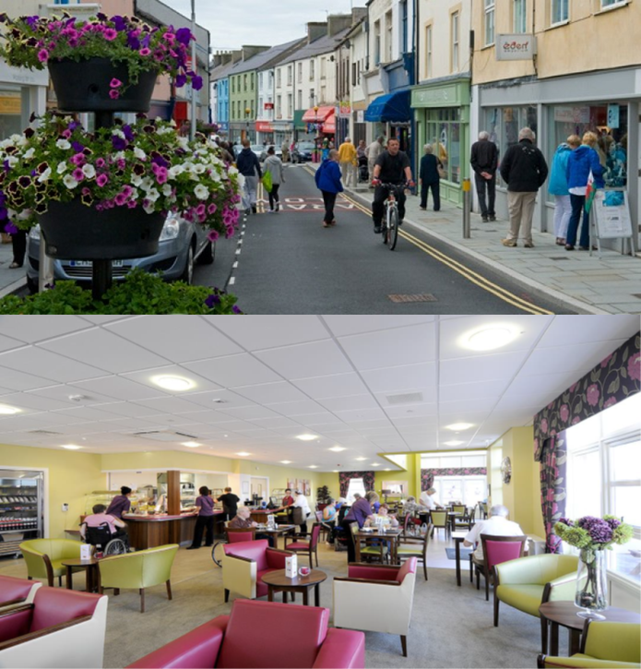
Policy priorities in the UK
Housing offers opportunities for join up between policy areas
We should build housing that can be adapted and sustain people through different stages of the lifecourse
Access to information and support is vital to make choices at the right time
Technology can open up opportunities
People should be able to chose to stay put or move on
Our home is a meaningful place

Slide 5
Underlying principles of social policy (based on UN principles)
Citizenship – valuing older people
Participation and engagement
Tackling ageism and discrimination
Promote positive images of ageing
Give older people a stronger voice in society
Co-production
Integration

Slide 6
Key questions for designing and planning for the housing needs & choices of older people (1)
Should we design housing & communities for intergenerational integration or segregation? How do we build an ‘age friendly’ environment suitable across the lifecourse?
Do we plan more specialist provision or more general lifetime homes?
Do you ‘age in place’ or move through choice to a potentially more fitting housing environment?
How can we plan for the diversity of an ageing population? How do we design for inclusion?
How do we support robust social and caring networks in different environmental contexts?

Slide 7
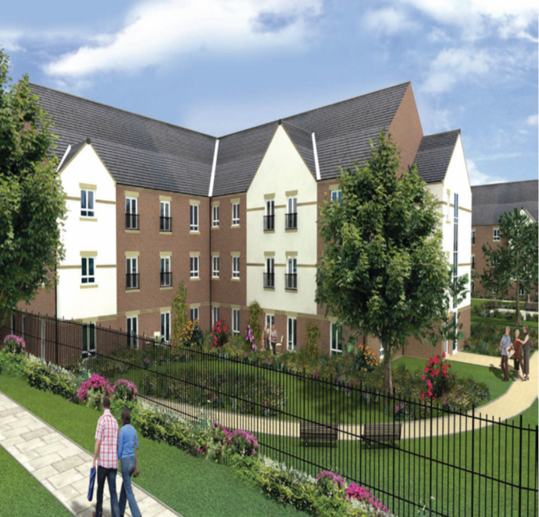
Key questions for designing and planning for the housing needs & choices of older people (2)
What are the design implications of the use of new technology?
Are rural communities good places to grow old in? What are the specific issues for valley and rural housing?
How can we design healthy environments? How do we design for people with dementia?
What are the implications for design in relation to climate change and its impact on older people?

Slide 8
Thank you for taking part and enjoy the day!
Professor Judith Phillips OBE
University of Stirling
judith.Phillips@stir.ac.uk
Twitter @judithp75851541

