Slide 1
Findings from Policy Makers Perspective
Dr Friederike Ziegler
friederike.ziegler@bthft.nhs.uk
Dr Friederike Ziegler

Slide 2
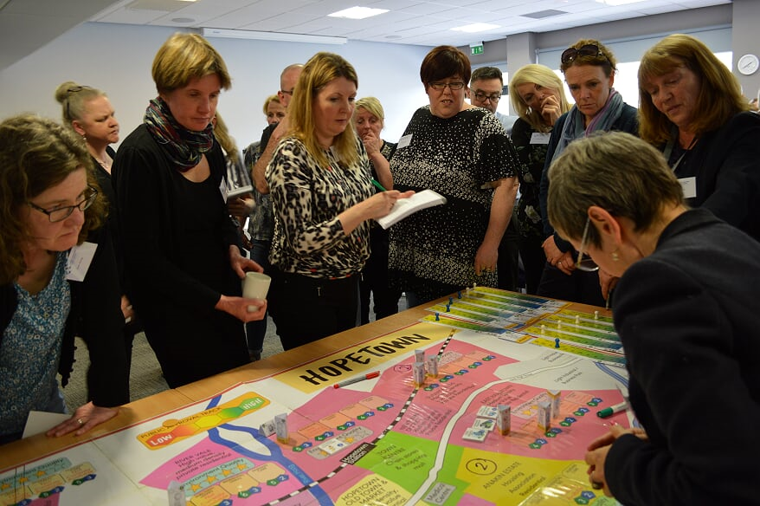

Slide 3
The Game
The Serious Game-
a surprisingly recognisable reflection of the world of policy and politics
Tensions
Resources
Politics
Values
Evidence

Slide 4
The Serious Game Framework
Policy Makers
Developers
The People
Service Providers

Slide 5
Linked recommendations – Policy makers LOOK TO THE FUTURE
Health & Social Care
Place housing development and the home at the heart of the integration of health and social care for an ageing population
Planning & sustainability
Set quotas and planning standards for high quality accessible and adaptable housing development
Marketing & public education
Create a positive narrative and vision around ageing which helps policy makers, communities, individuals and families to plan ahead for later life

