Slide 1








Findings from the service providers’ perspectives
Dr Melanie Lovatt

Slide 2
The Game
Event participants shared their knowledge, analysed policy challenges and priorities, sought to understand how policy is experienced by older people, and discussed what we can do to prepare for 2030. They also played a Serious Game to help examine the issues we face and decide what to do about them.

Slide 3
The Serious Game Framework
Policy Makers
Developers
The People
Service Providers
Findings drawn from different games on different days
The challenges of being a note-taker: to intervene or not to intervene!

Slide 4
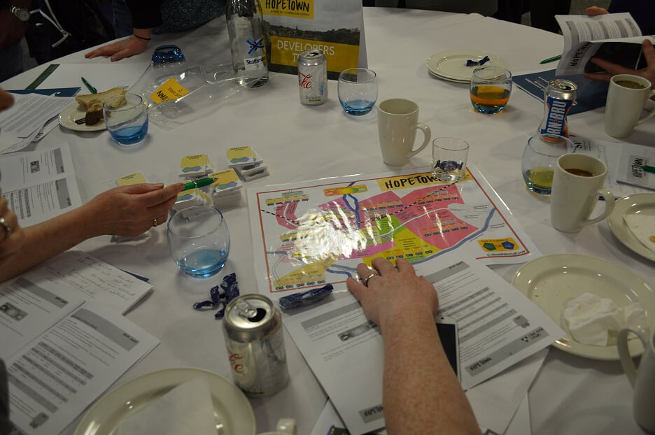
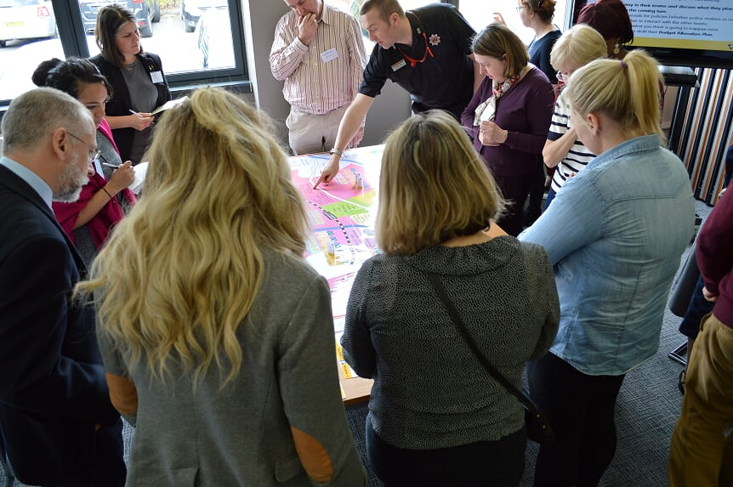
Main impression: it’s good to talk!

Slide 5
Linked recommendations – Service providers
BE INNOVATIVE & AMBITIOUS
Create a vision – a narrative – and communicate it to all professionals and citizens.
Work with developers to find innovative practice.
Invest more in supporting delivery of the ambitions of older people – improvement in support and service redesign, as well as bricks and mortar.
Work with care and repair – need to adapt existing properties to enable people to remain in their own homes.
“It is better to work in collaboration and partnership WITH ALL GROUPS”

Slide 6
Linked recommendations – Service providers
BE INNOVATIVE & AMBITIOUS
Innovation has to be creative and needs space to step back from the everyday and status quo.
Think outside the box and don’t just focus on the budgets.
Emphasise macro changes over micro/individual.
Look for imaginative solutions including learning from existing successful models.
“Making it flexible, resourceful and adaptable will improve living standards”

