Slide 1
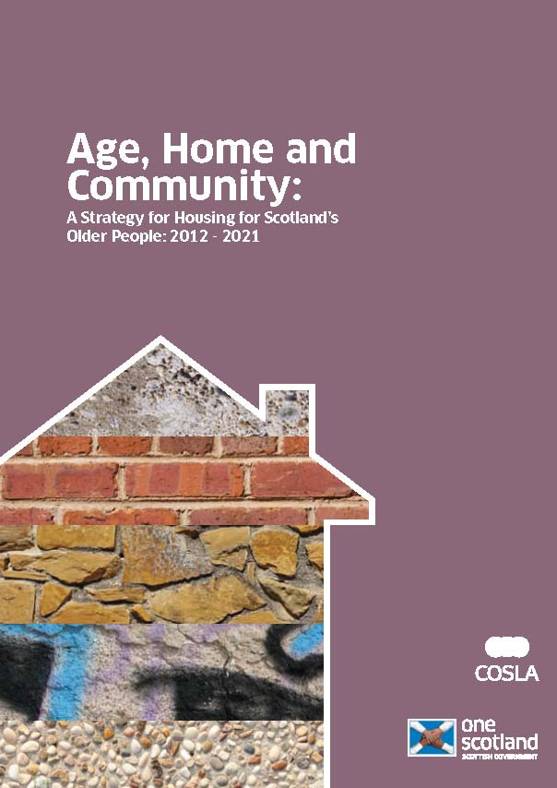







Findings from the stakeholder perspective
Dr Jane Robertson
Notes:
Putting older people at the heart of housing choices and decisions

Slide 2
The Game
The ‘Older People’ group was tasked with speaking for the older people in the game. In the game, tokens representing exemplar older people are placed on the map to indicate how housing or other accommodation is being used. The team make decisions on these people's behalf based on what they think the likely choices of these older people would be. They also represent these people’s interests by talking to the other teams and advocating for budget, housing and services to maintain the well-being of older people in Hopetown.
Notes:
Getting housing ready for an ageing population requires planning and action.

Slide 3
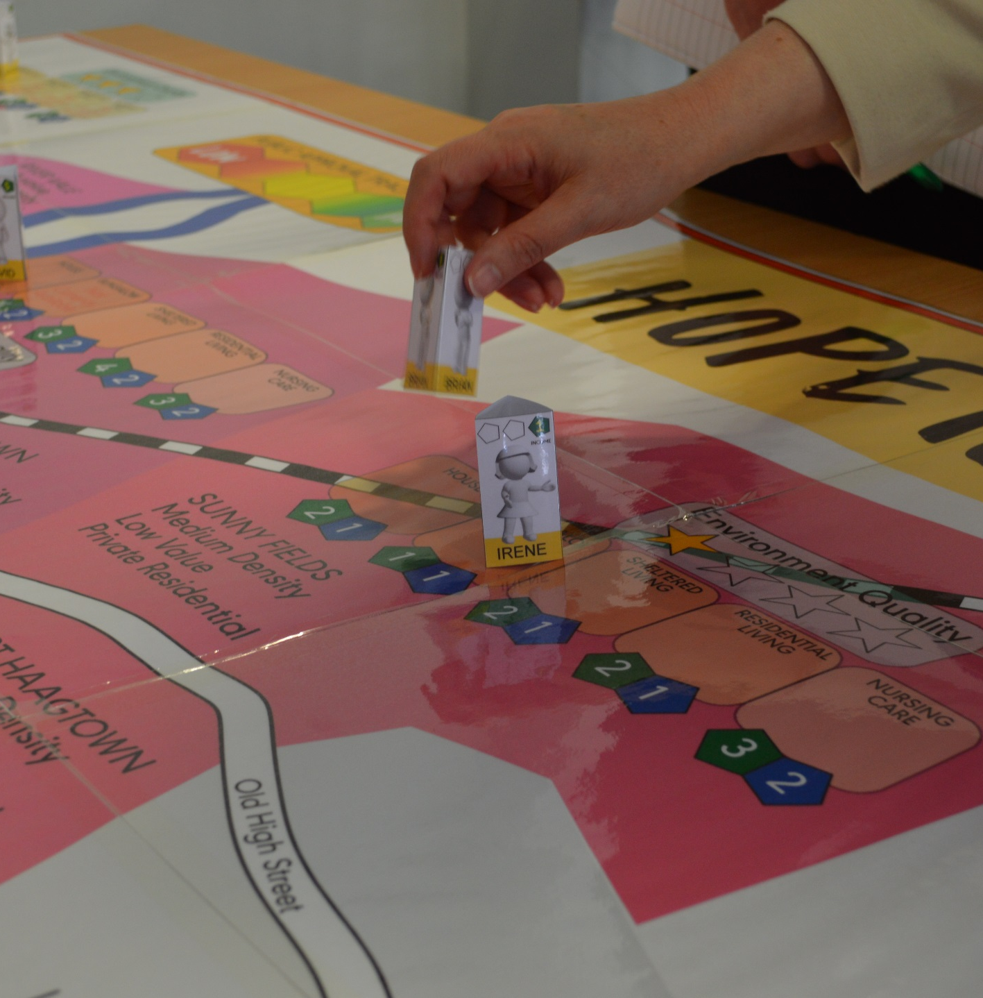
The Serious Game Framework
‘The People’ group: starting the game involved looking at older people’s well-being and income to consider who might need support to stay in their own home and/or who might benefit from moving e.g. from own home to supported living.
Policy Makers
Developers
The People
Service Providers
Notes:
The Older People Team are advocates for the representative older people in the game. The main metric is the well-being of our game older people, who may move around the town to different districts. They are represented by stand-up counters. Each of these is a representative exemplar for a number of people in similar circumstances. The counters also have an Income value, which gives an indication of their ability to service their own needs from their own resources. This is compared with the cost of living in the various spaces on the map.
Each older person counter has an associated Well-being Track, which is updated each game turn. As the game goes on, there is potential for more Older Person Counters appearing on the map to
reflect greater demands of an ageing population. The older person's position on their track is modified based on the decisions taken by player teams. Also, at the start of each turn, a card is drawn for each Older Person to see how their well-being alters with time, naturally.
Game factors that might affect the Wellbeing track include:
◦ Having nowhere affordable to live.
◦ Environment quality
◦ Availability of services
◦ having to travel to access amenities
◦ moving away from friends and family
◦ leaving the initial home
NOTE A STORY /SOMETHING YOU SAW THAT MAKES THE EXPIERENCE LOOK EXCITING AND FUN

Slide 4
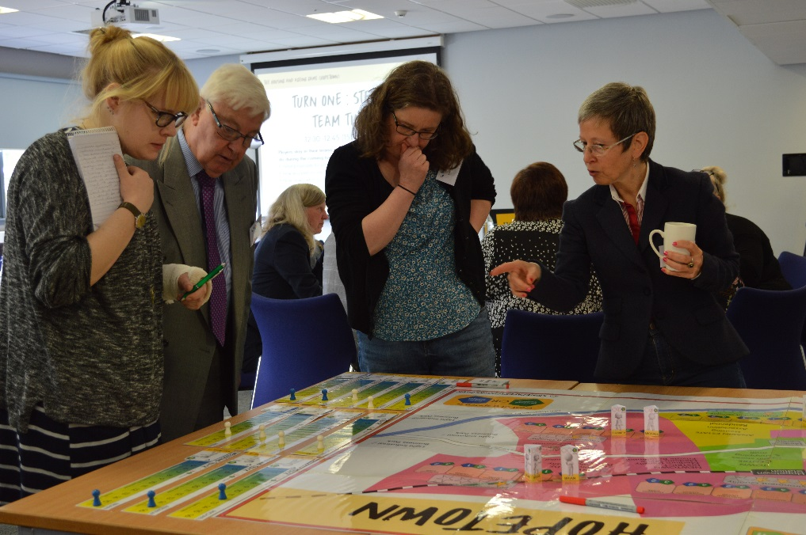
COMMUNICATE, COLLABORATE & COPRODUCE
It helped if developers and policy makers made the first move to approach older people to ask what they wanted. And it could help when service providers acted as a bridge between service users and these other stakeholder groups.
Speaking with a small number of representatives from each stakeholder group was helpful to foster constructive communication. This helped to support those who required more time or less noise to stay part of the ongoing dialogue.
Notes:
Communication was an important element of the process of the game which mirrored the real-life challenge of supporting effective communication to hear the voices of service users. This can involve including those who may not be so comfortable either with large group consultations or making the first move. Listening to the views of older people was essential for ensuring positive outcomes as the game progressed since one marker of ‘success’ for policy makers was the public approval track which relied upon older people feeling that their views and opinions had been heard, and their choices and needs had been met.
It could be daunting for service users to approach developers and policy makers. It helped if developers and policy makers made the first move to approach older people to ask what they wanted. And it could help when service providers acted as a bridge between service users and other groups.
It could be challenging for some service users to have their voices heard fully in the process. People often had to shout to have their voices heard, which wasn’t comfortable for everyone, particularly in a large group environment. Speaking with a small number of representatives from each stakeholder group could be helpful to foster constructive communication and avoid those who required more time/quieter style withdrawing from the dialogue.
At the start:
People did not really know what they wanted.
It was difficult to get agreement in what the older people really wanted.
It turned out to be much more complicated than expected.

Slide 5
COMMUNICATE, COLLABORATE & COPRODUCE
Having a choice about where to live matters. As income dropped and/or health deteriorated, older people often required support either to stay in their own homes or to move to suitable supported living – but people wanted a say in these decisions. Even if people had to move home, maintaining a good quality environment and staying connected to their community mattered.
To achieve this choice required collaboration across the different stakeholder groups. Peripatetic services could help people stay in their own home. Developers building affordable homes in good quality environments could support the transition to a new home to downsize or to access supported living. Investment from policy makers could support both these aspects of housing. Building new lifetime homes was another longer-term option.
Notes:
Indeed, older people’s main concern was having a choice and say in where they lived. Collaborative and partnership working across stakeholder groups is paramount to making this happen.
With 4 years passing notionally at each stage of the game, most older people’s incomes had dropped and they could no longer afford to stay in their current homes. Without subsidy, older people like Irene could be forced to move to a cheaper location with a poorer quality environment and greater distance from their existing community. This could reduce health and well-being for instance by increasing social isolation and loneliness. Most older people were relatively healthy after 4 years, but several ended up in sheltered housing before it was necessary if it was cheaper to move to this type of accommodation rather than stay in their own home, which resulted in a reduction in their well-being. Lack of affordable choices therefore tended to push people into sheltered/residential living before their health warranted it. Each change that was made greatly affected service users’ well-being.
Avoiding this type of scenario required collaboration with service providers to put peripatetic services in place so people could stay in their own home as long as possible. When this wasn’t possible or desirable, collaborating with developers to build new housing in affordable areas, particularly those central to town, was necessary. Influencing policy makers so that they understood the need to invest in affordable housing through subsidises to developers was helpful in the longer-term for keeping well-being relatively high across the group of older people in the game. However, it could be difficult to have these types of conversations in the midst of the game, as in real life, so frequently the focus was on subsiding individuals with money to stay in their own homes. Over time this became unsustainable with budget cuts and continually reducing individual incomes. And so, when collaboration was not taking place, the ultimate endpoint of the game was many older people who were homeless as they could not afford to stay in their existing home but there were not sufficient affordable homes for downsizing.
By the end of the game, there was a clear tension between meeting the immediate needs of the people and investing in properties for the future, and one question was on everyone’s lips: ‘How do you plan for the future while also addressing immediate chaos?’ Pressures included: budget cuts, deteriorating health and wellbeing, more Older People needing to be homed. If budget wasn’t allocated appropriately, people were going to end up homeless – many were already at risk.

Slide 6
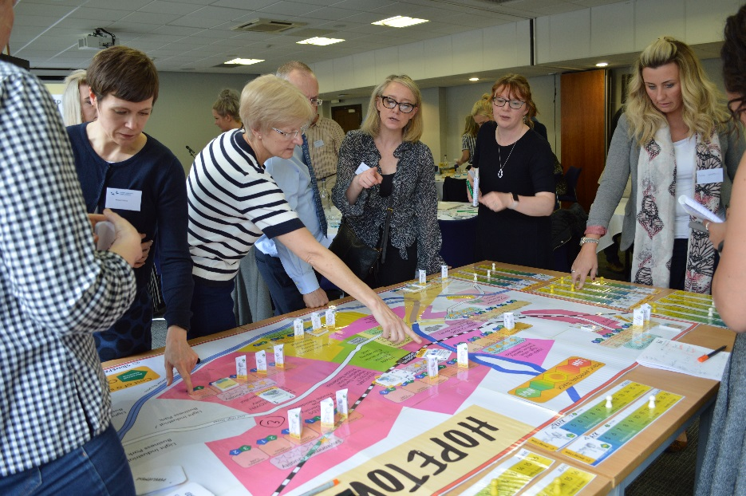
COMMUNICATE, COLLABORATE & COPRODUCE
Balancing investment by policy makers at the individual level/for immediate outcomes alongside longer-term investment in accessible/affordable homes produced better longer-term well-being for the wider group of older people.
A whole-community strategy is necessary for driving sustainable development:
Considering infrastructure, involving property developers and planning joint ventures with service providers.
Speaking to end users as much as possible as they are experts on their wants and needs.
Notes:
Balancing investment at the individual level/for immediate outcomes alongside longer-term investment in accessible/affordable homes produced better well-being scores for all. Discussions leaned heavily towards whether it was better to subsidise people in the wealthier areas or move them to more affordable ones and risk damaging their health and wellbeing. Subsidies would mean less money for future sustainability – or anything else.
Working in an integrated away across sectors was seen as a necessity as housing is intrinsically linked to security, community, transport, mobility, and good health care as people develop long-term conditions. Many in the older people’s group were concerned that there weren’t many options for downsizing to different types of accommodation, and there was limited access to adaptations that could help people live in their existing home for longer.
It was therefore considered that meaningful and real co-production needs to be a priority. This involves getting older people involved at the beginning to have a major say in developing services and building new housing. While a person-centred approach to individual needs is necessary on a day to day basis, a whole-community strategy is necessary for driving sustainable development:
Involving infrastructure, property development and joint ventures involving service providers.
Discussing ideas with the end users and asking what is required for them before making decisions.
Speaking to end users as much as possible as they are experts on their wants and needs.
The views of the community are very powerful when harnessed and vocalised. Voice of older people not heard as much as it should be; policy makers, service providers and developers predominated – consultation with older people could be a bit tokenistic. Most successful was a mix of policy makers and older people working with service providers and developers. Essential that we work outside of existing structures and silos to achieve new outcomes for older people. The powerful nature of collaboration and positive communication came across very strongly in ensuring effective coproduction.

