Slide 1

Changing the Narrative: Responding to the developmental needs of looked after children and those who care for them
Stage 2 ‘Stable care: developmental dialogue’ day
Tuesday 20/02/2018 09-30
Scottish Universities Insight Institute, Collins Building, University of Strathclyde 22 Richmond Street, Glasgow

Slide 2
Aim of Today – Sharing knowledge and experiences
Safe space to…
Reflect on stage one
Consider the current narratives around looked after children
Explore the idea of an organizing frame of child development and what it might mean for you
Discuss what we might need from other disciplines/colleagues to achieve this
Notes:
You will all have been busy talking to colleagues and service users about day one …..

Slide 3
Reflection essentials
Time
Support and prompts
Freedom to experiment with thoughts and beliefs
Acceptance and curiosity from others
Space to change your mind

Slide 4
Remember….remember….. the 27 and 28th November?
Traffic and travel chaos on the Monday……..
Celtic Park was the venue both days……….
Have a look at the programme on the wall to remind yourself…..

Slide 5

Key Messages from Stage 1
Take time to individually note on the stickies the key messages you heard from the stage one day
Play ‘snap’ at your table - What are the themes?
Rank the messages from most important to least important (as a group)
Would this ranking change if it was health? education? policy makers who did this list?
Agree one key message for the wall

Slide 6

What do we mean by narrative?
Who is telling the story
How does the telling of the story and the storyteller affect the narrative
Whose story is it
Who has the power
There are some visuals/words and ‘stories’ on the wall to have a look at………
There are some very short scenarios to trigger discussion on your tables……..

Slide 7
Developmental Orientation: An organizing Frame?
What are the optimum conditions for emotional, physical and cognitive growth?
Who or what needs to be the scaffolding to support this?
What do they need to do?
Notes:
Building on this morning….
Space to think about current narratives – often deficit or risk focused.
Dev orientation allows us to consider growth rather than damage – attention on what a child needs for growth, what needs to be repaired or replanted, what needs to be supported to grow and develop
ALSO - our and our organisations needs for growth and development – what needs to be in place
Importance of past present and future – how this impacts on growth and change
A frame – strands working together with the same aim and focus – to support growth – how might a developmental orientation help to ensure a shared language and focus
Doesn’t deny the external conditions – essential that dev orientation isn’t limited to that within the child or parent – also conditions (think back to ecological framework) impact of wider structural factors

Slide 8
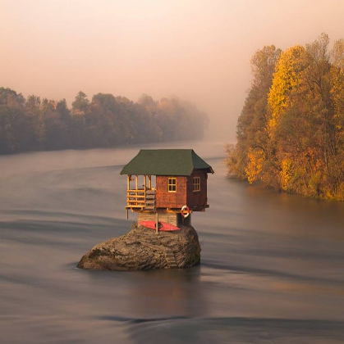
Past, present and future
Notes:
What underpins us – knowing/being/doing
Recognising the need to think about the impact of the past on the present and future – what are the foundations?
How are we and the people we work with supported from earlier on to current and future(boat, built on rock, life belt) what happened to the others?
Think about this in terms of children and staff
Often too much focus on one or the other – need to hold all three in mind
DEV orientation needs to take these three temporal dimensions in mind

Slide 9
Promotion of Integration
For the child - to compensate and make sense of fragmentation and dysregulation
For our thinking – need to be open to complex ideas from different fields
For the system around the child - needs to work in a cohesive and integrated manner

Slide 10
Knowing, Being and Doing
(Lefevre 2015)
BEING
KNOWING DOING
Notes:
Possible incorporation of the notion of consilience around this concept – knowing/doing/being discussed as praxis in the Child and Youth Care literature, and Head, Heart and Hands in the Social Pedagogy literature.
Knowing – external knowledge – research ‘normal development’ – avoiding the pathologising of children or of adult responses to pain ALSO self knowledge ALSO how we help children to know and understand their lives
BEING – ethical orientation, our values and beliefs. Who am I in this work? Supporting the child to have sense of him/herself
DOING – the skills and interventions required – how would we do a developmental orientation? What would that involve? Ways of doing.

Slide 11
Knowing, Being and Doing
Child or young person
Parent
Self – carer, practitioner, manager, policy maker, researcher
Organisation – at all levels
System – around the child and working together

Slide 12


What does a developmental orientation/organising frame mean for ….
        KNOWING
BEING
              DOING

Slide 13
Adapting a developmental frame
On your own - Key features of a developmental approach/frame
SNAP
Group themes – knowing, being and doing
Write up on your frame
Notes:
RANKING?

Slide 14
What do we need from others?
From health?
From Education?
Strategic leaders and policy makers?
Notes:
Anything to add to the frame?

Slide 15
REFRAMING
What does this mean for looked after children and those who care for them?
What does this mean for me/us in our practice/agencies/sector?
What does this mean for Health?
What does this mean for Education?
What does this mean for Strategic leaders and Policy makers?

