Slide 1



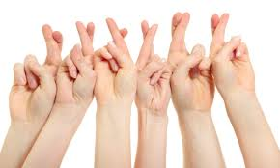

Self-determination and the determination of Deaf selves
Graham H. Turner

Slide 2


Slide 3

Self-determination means the right of a people to determine its own destiny.
It is made clear in Article 1 of the Charter of the United Nations.

Slide 4
Who ‘speaks for’ signing people?
Previously…
  Scottish Association for the Deaf
  Gang of Four (RNID, BDA, BAHOH, NDCS)
  CACDP
  UKCOD/SCOD
  Training Strategy Group (UoE, SASLI, CACDP, SCOD)
  BSL & Linguistic Access Working Group
  Cross-Party Group on Deafness/All-Party Parliamentary Group on Deafness
  National Advisory Group (NAG + YNAG, DBNAG)
  Deaf Sector Partnership/BSL (Scotland) Act 2015 Partnership

Slide 5
Barriers
So who was involved?
What power did they have?
How effective was communication?
Who represents you in public life today?

Slide 6
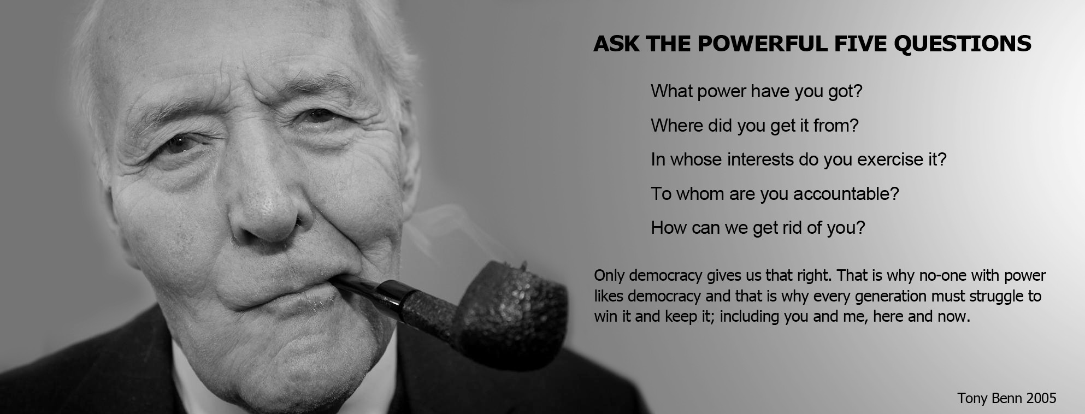

Slide 7
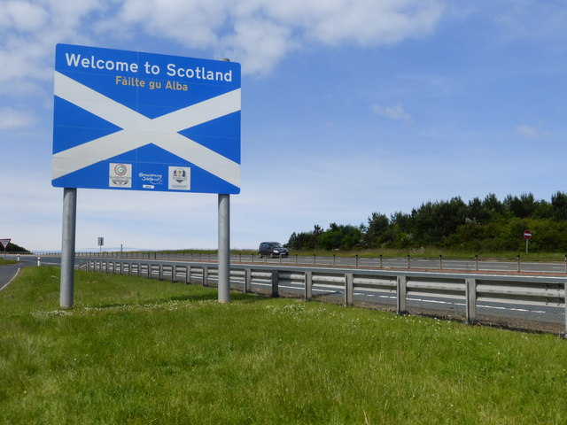
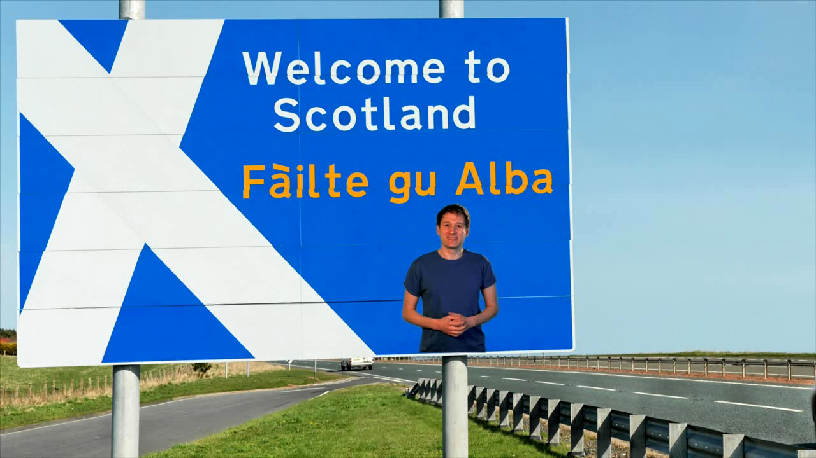
The BSL (Scotland) Act 2015

Slide 8
Consult, consult, consult
The BSL (Scotland) Act creates a duty for public bodies to consult BSL users
Who gets consulted, how and by whom?
What happens to the resulting information?
Result: consultation fatigue?
Do they just consult on ‘Deaf issues’?
What even is a ‘Deaf issue’
How does information flow?

Slide 9


Slide 10

Deafland’s Parliament
1. Who can stand for election?
2. Who is eligible to vote? Is it based on…
Your audiogram?
Your language ability/preference?
Your membership of an organisation?
Your family background?
Which school you went to?
Something else?
DEAFLAND

Slide 11
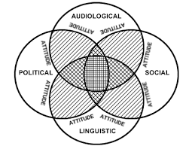
Who is Deaf?
Baker-Shenk & Cokely 1980

Slide 12
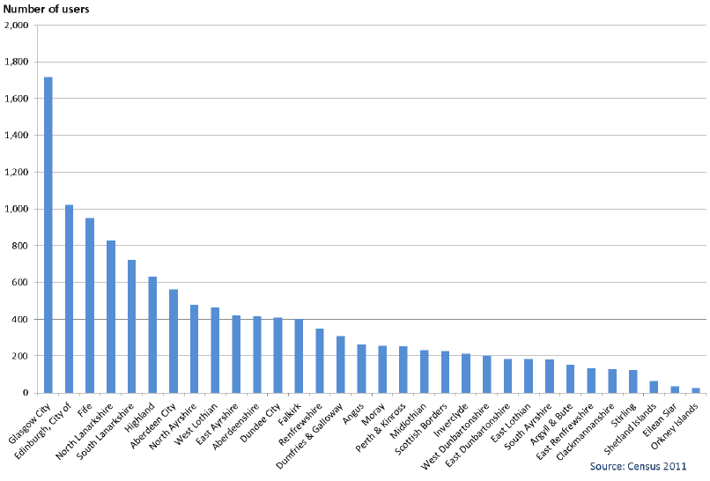

BSL users in Sc otland
All=12,533
Deaf=3,729

Slide 13
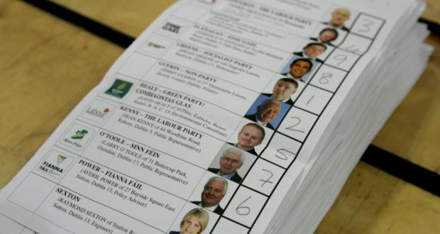
32 Local Authority areas each organise an election…
All manifestos and debates are in BSL…
Candidates must be deaf BSL users…
Every deaf BSL user on a voluntary register gets to vote…
Those elected must hold regular local meetings in BSL to check people’s views on key issues …
New election held before each BSL National Plan is written.

Slide 14
So – WHY a Signing Parliament?
The country needs honest representation of community’s views to deliver the BSL Act
“If you always do what you’ve always done, then you’ll always get what you’ve always got”
Old communication issues are irrelevant in a digital world
It will promote the use & understanding of BSL
It is fair and logical to recognise the expertise of BSL users on matters affecting Deaf lives
It will strengthen the resilience of the signing community

Slide 15
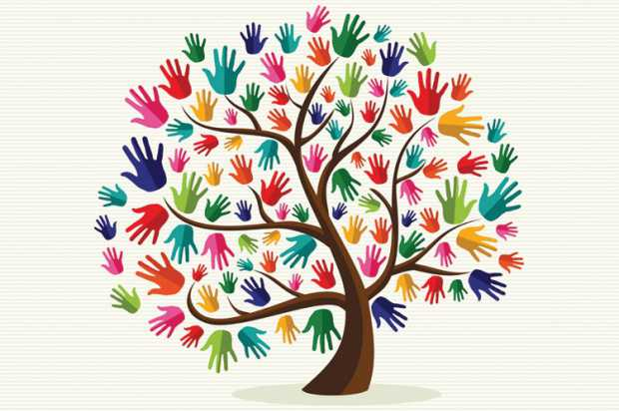
g.h.turner@hw.ac.uk

