Slide 1



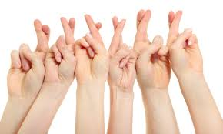

SCOTLAND’S DEMOCRATIC DEAFICIT
A MODEL SIGNING PARLIAMENT
Graham H. Turner & Stefanie Reher

Slide 2
Introductions: Organisers, SUII, SPICe
https://www.scottishinsight.ac.uk/Programmes/ThemedCall201819/DemocraticDeaficit.aspx
@DemDeaficit #DemocraticDeaficit
Housekeeping & Communication
  Emergencies
  Comfort breaks
  Refreshments
  Multimodal interaction
  Microphones & text
  Role of the Chair
  Filming bit.ly/2XfFAFM

Slide 3
The project
May 31st (today!)
  This event will focus on WHY we are talking about the idea of a ‘Signing Parliament’? Do BSL users feel well represented in society? Are changes ‘in the air’ that make now a good time to discuss this question?
August 23rd (Glasgow)
  Our second workshop asks WHAT might be the best way to bring BSL users’ views forward in democratic processes? Can we take inspiration from other communities in Scotland (eg Gaelic speakers) or Deaf communities around the world?
November 22nd (Edinburgh)
  In our final workshop, we address the question of HOW the changes you want to see could really happen. What action is needed and who needs to take it?

Slide 4

Today’s Programme
  10.15 Background
  10.30 Ben Fletcher
  11.00 John Bosco Conama
  Open Discussion
  12.30 Lunch
  13.30 Orientation
    (Alison Phipps)
  13.45 Jeff McWhinney
  14.15 Graham H. Turner
  Open Discussion
  16.15 Conclusions
  16.30 Close

Slide 5


Slide 6
This project is interested in…
1. The lives of Deaf people – which, for today’s purposes, means people who use signed language.
2. Both representation and participation –
i. who can most appropriately ‘speak for’ Deaf people in public affairs;
ii. how can Deaf citizens contribute most fully to public decision-making.

Slide 7
Key areas of discussion
Self-determination & legitimacy
  What gives some people the right to make decisions that affect others’ lives?
Representation & authority
  Who do people trust to act or talk for them in the public sphere?
Information & informed decision-making
  How do we make sure that people have access to the information they need to reach good decisions?
Community & collective action
  What are the benefits of sharing responsibility for society’s decisions?

Slide 8
Two levels
Mainstream politics (national, regional, local)
Deaf/BSL community politics & policy
Questions such as…
Who gets consulted?
Who are they consulted by?
What are they consulted on?
Who has access to what information?
How are the conclusions reached?
Who tracks what happens next and how? etc

Slide 9
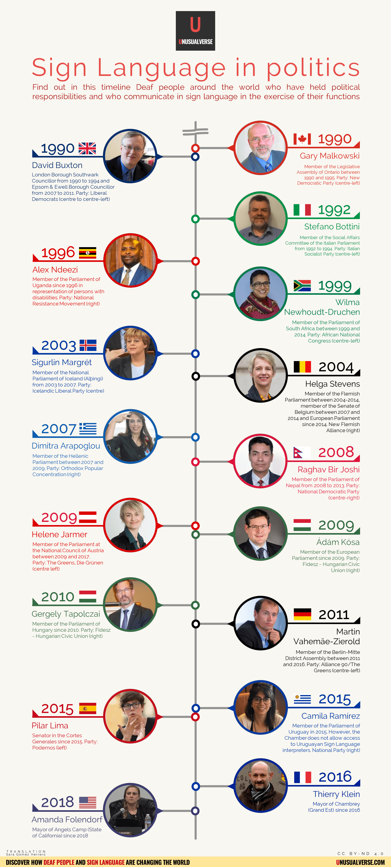
History
Of previous efforts
Of signers who made it
Of barriers – what, why?
And today…?

Slide 10
Politics of BSL timeline
  1975 British Sign Language gets a name
  1987 BDA report “BSL: Britain’s Fourth Language”
  1992 BDA’s BSL Dictionary published
  1999 First BSL recognition march in London
  2003 Westminster ‘recognises’ BSL
  2010 Cathie Craigie MSP consults on recognition in Scotland
  2013 Mark Griffin MSP lodges a proposal for a BSL (Scotland) Bill
  2015 BSL (Scotland) Act passed
  2017 First National Plan for BSL launched

Slide 11





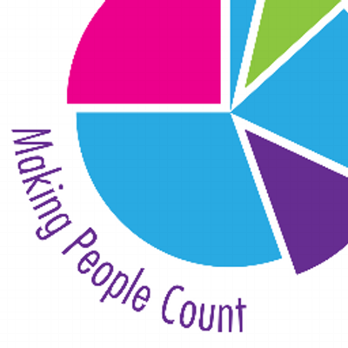
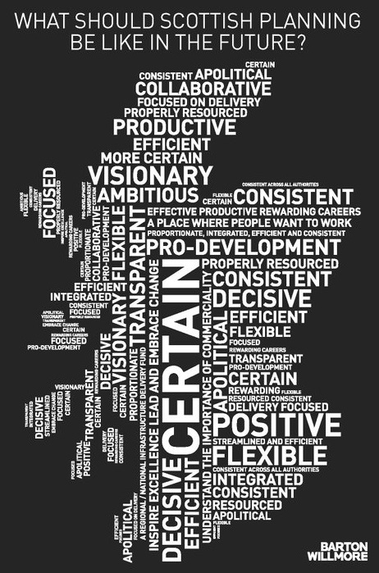



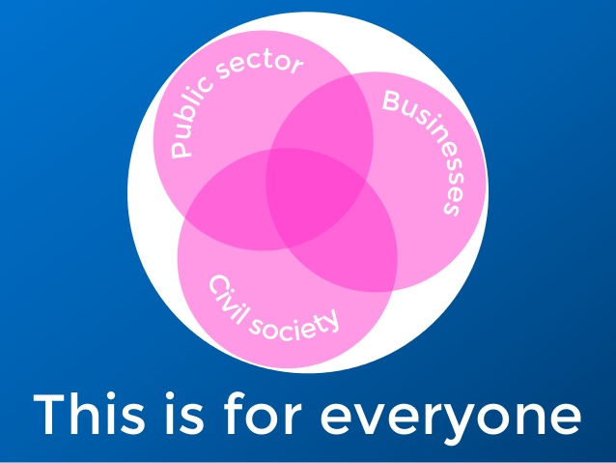

Participation in Scotland 2019

