Slide 1
Finding our political voice!
A campaign for the
Irish Sign Language Act 2017
Dr John Bosco Conama
Centre for Deaf Studies
Trinity College Dublin
IRELAND
“Signing Parliament”
Workshop 1
Scottish Parliament,
Edinburgh
SCOTLAND
Friday, 31st May, 2019

Slide 2
Structure of this presentation
The context
My observations / reflections
Political representation?

Slide 3

The Context

Slide 4

Few things to point out!
My role as a scholar-activist (or it should be an activist-scholar?)
Irish Sign Language Act 2017 was the fourth legislation passed by the the Oireacthas (the parliament of Ireland) that was sponsored by the non-government representative since 1937 and eighth since 1922 (Oireacthas Library and Research Service 2019, personal communication)
The current government is a minority one - supported by a Confidence and Supply Arrangement
The campaign was community-led (Conama forthcoming) and heavily invested in the social media activism (Leeson unpublished)

Slide 5
Social Justice
According to Fraser (2005), social justice means parity of participation
Parity of participation requires strategies of economic redistribution, cultural recognition and political representation (Mladenov, 2016)
Therefore, political representation is one of the key strategic points of achieving social justice!

Slide 6
Nature of our political system
Different modality
Phono-centric nature (examples see Emery 2009)
Diversity in representation severely limited by dominance of political parties and electoral systems

Slide 7
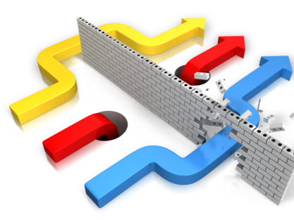
In 2010, based on a legal advice
Once received legal advice; it is clear to us that a political campaign was absolutely required rather than pursuit of legal redress and we had to up the ante!

Slide 8
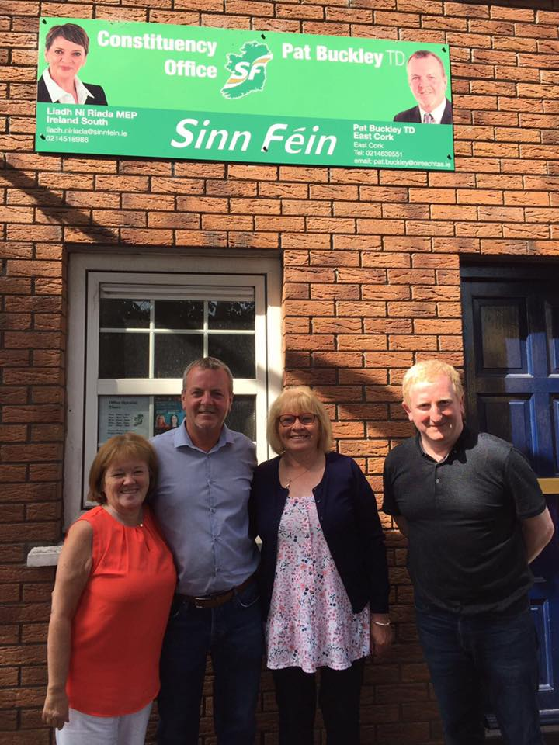
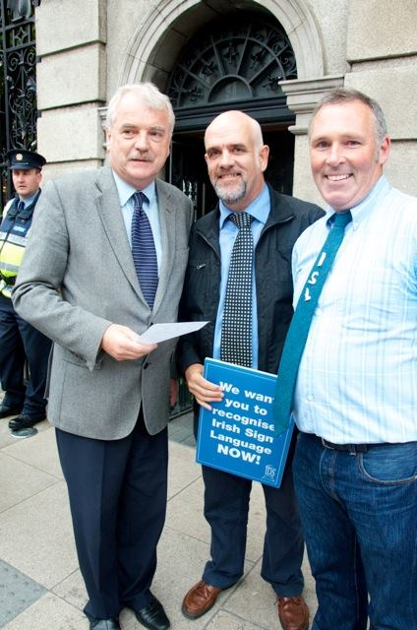
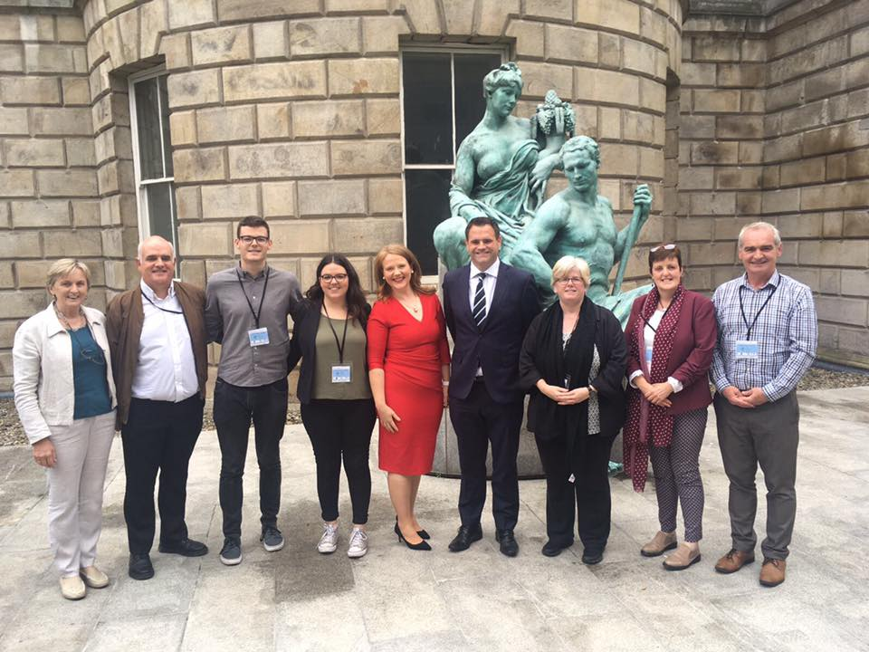
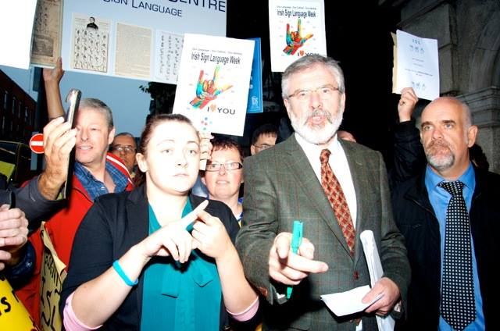
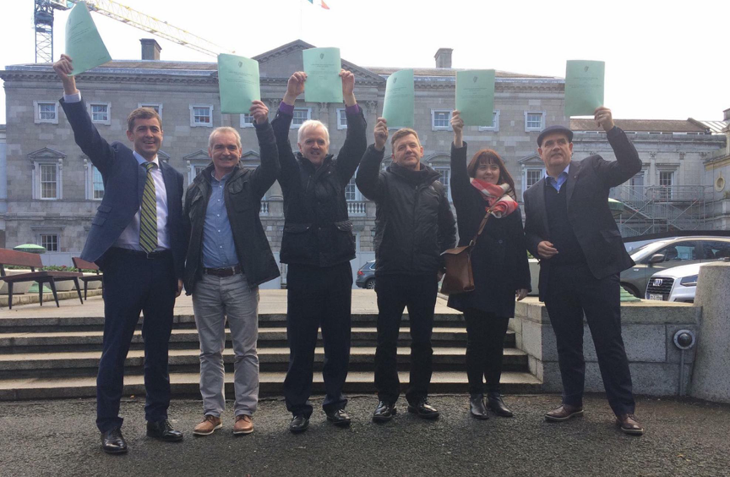
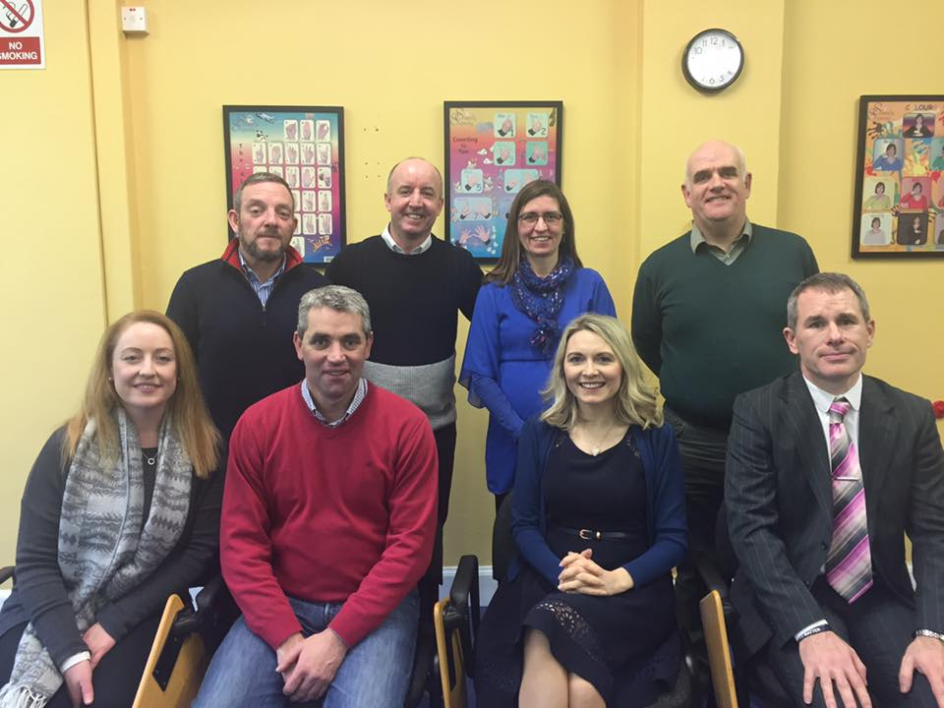
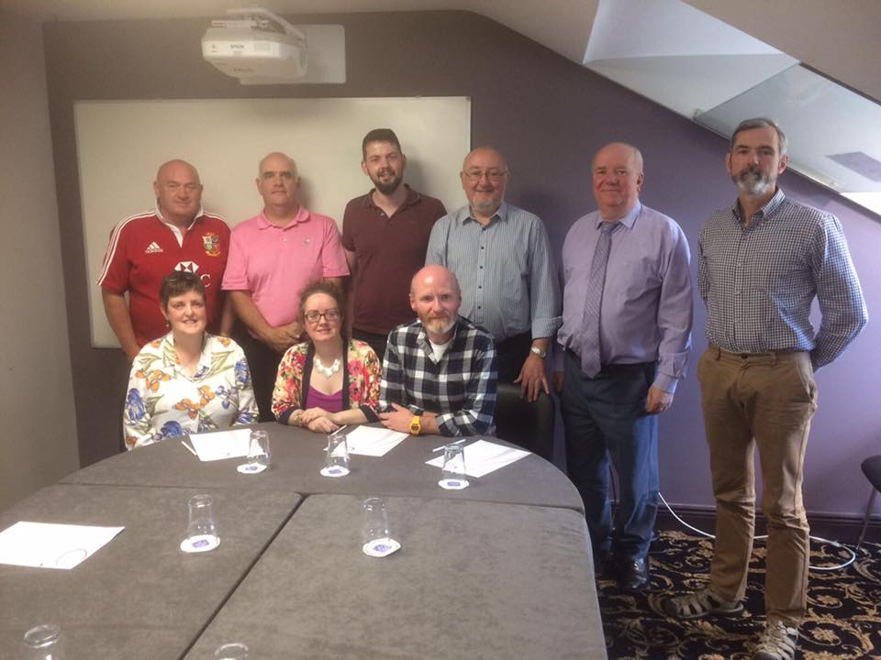
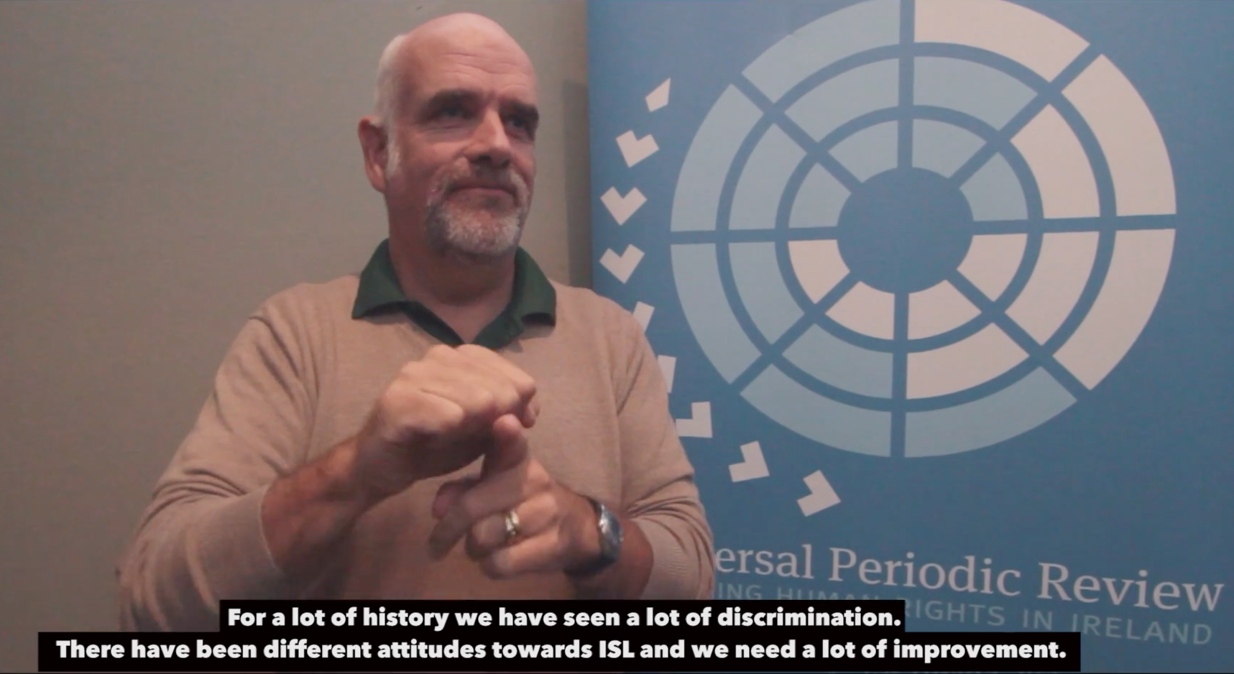
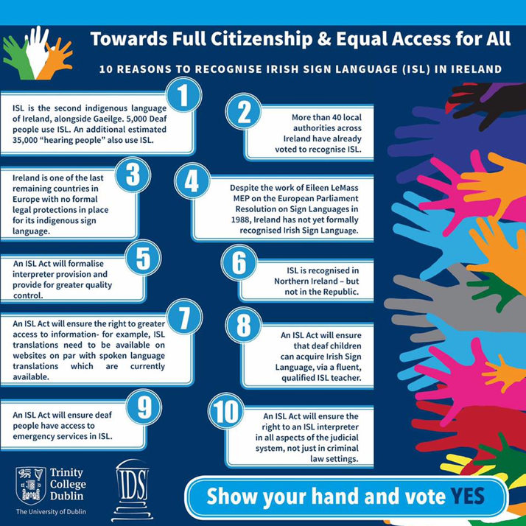
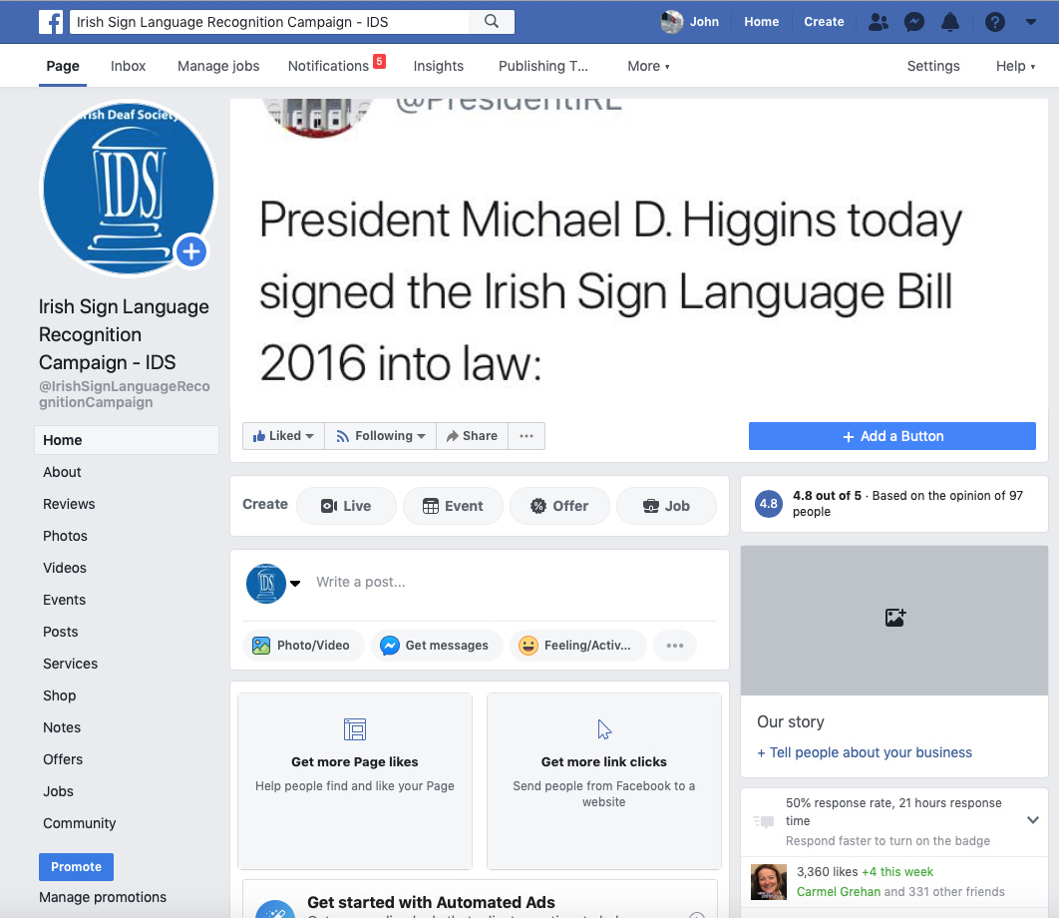
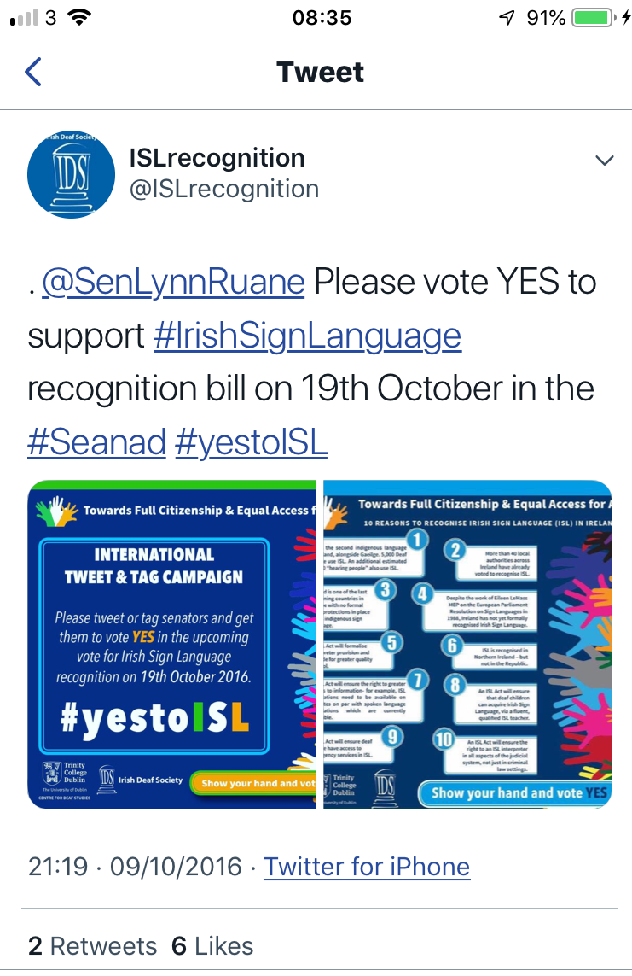
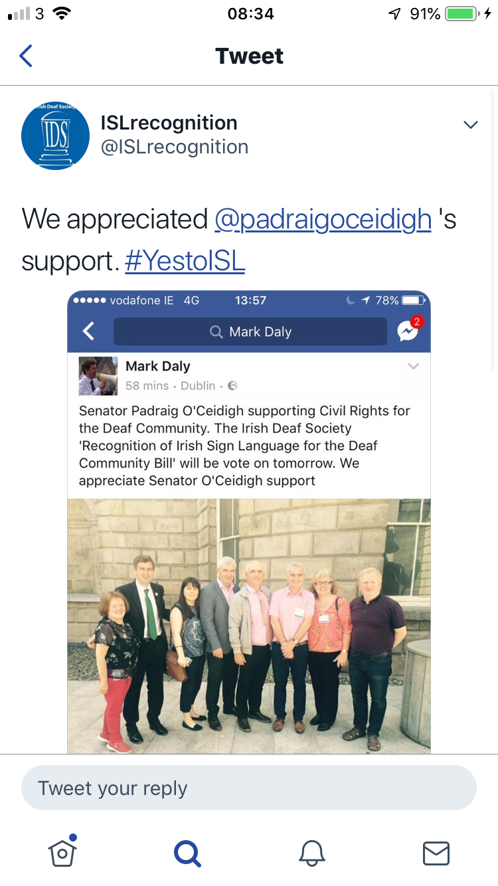
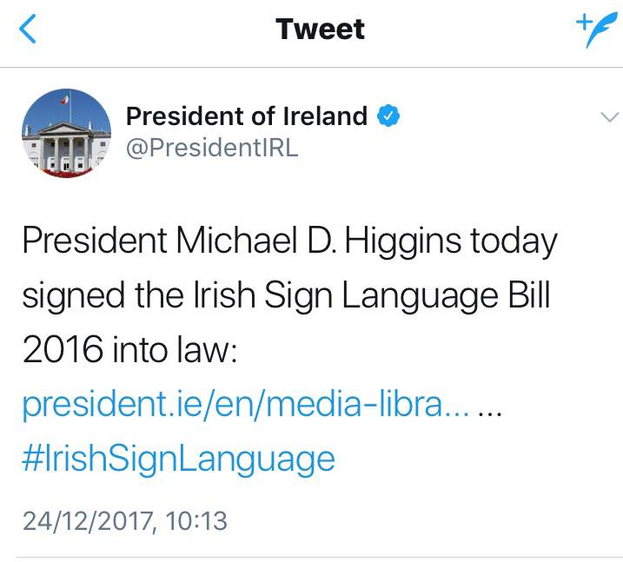

Slide 9
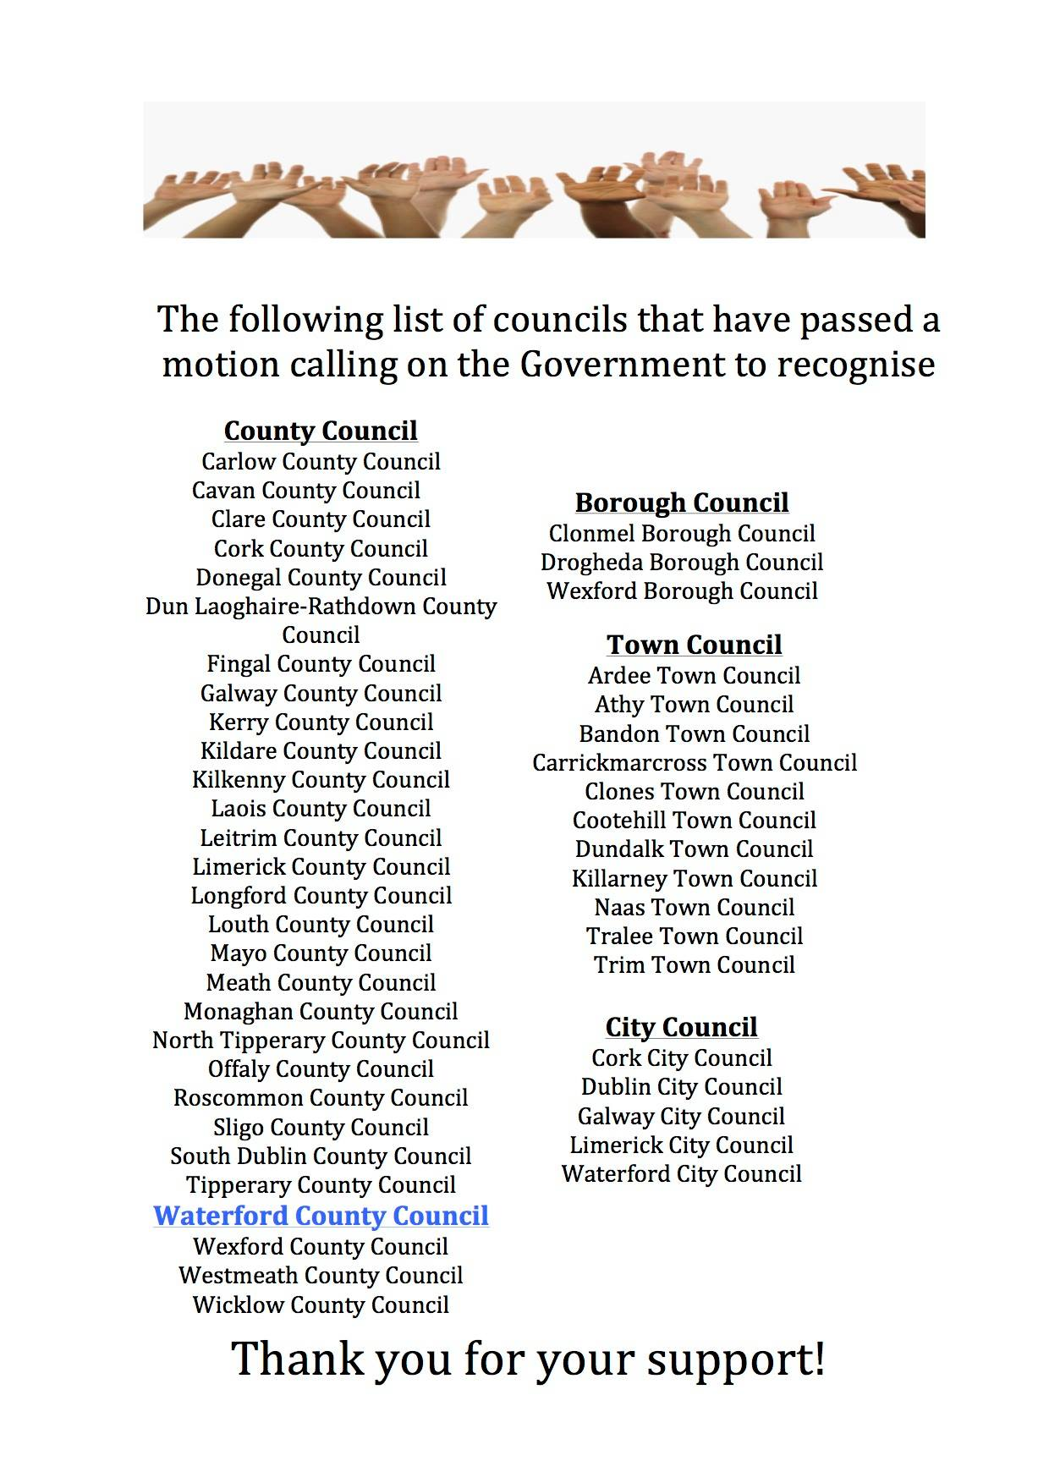
Lobbying local councils
“The campaign not only engaged with local governments, but also with local media. In 2012, Monaghan County Council became the first local authority to pass such a motion after one of its councillors visited an ISL photography exhibition at a local gallery and decided to propose a motion. When reflecting upon this motion, the IDS realised the huge potential impact that could take place at a local level. The campaign continued, reaching completion with Waterford County Council becoming the 48th and final local authority to pass the motion. The level of coverage in local media appeared to show the success of putting forward this motion at a local level.” (Conama, forthcoming)

Slide 10
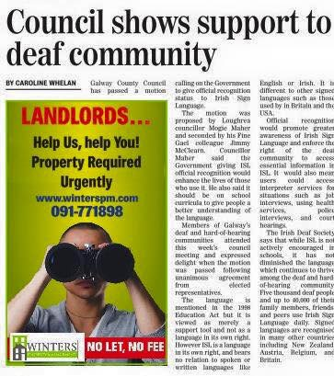
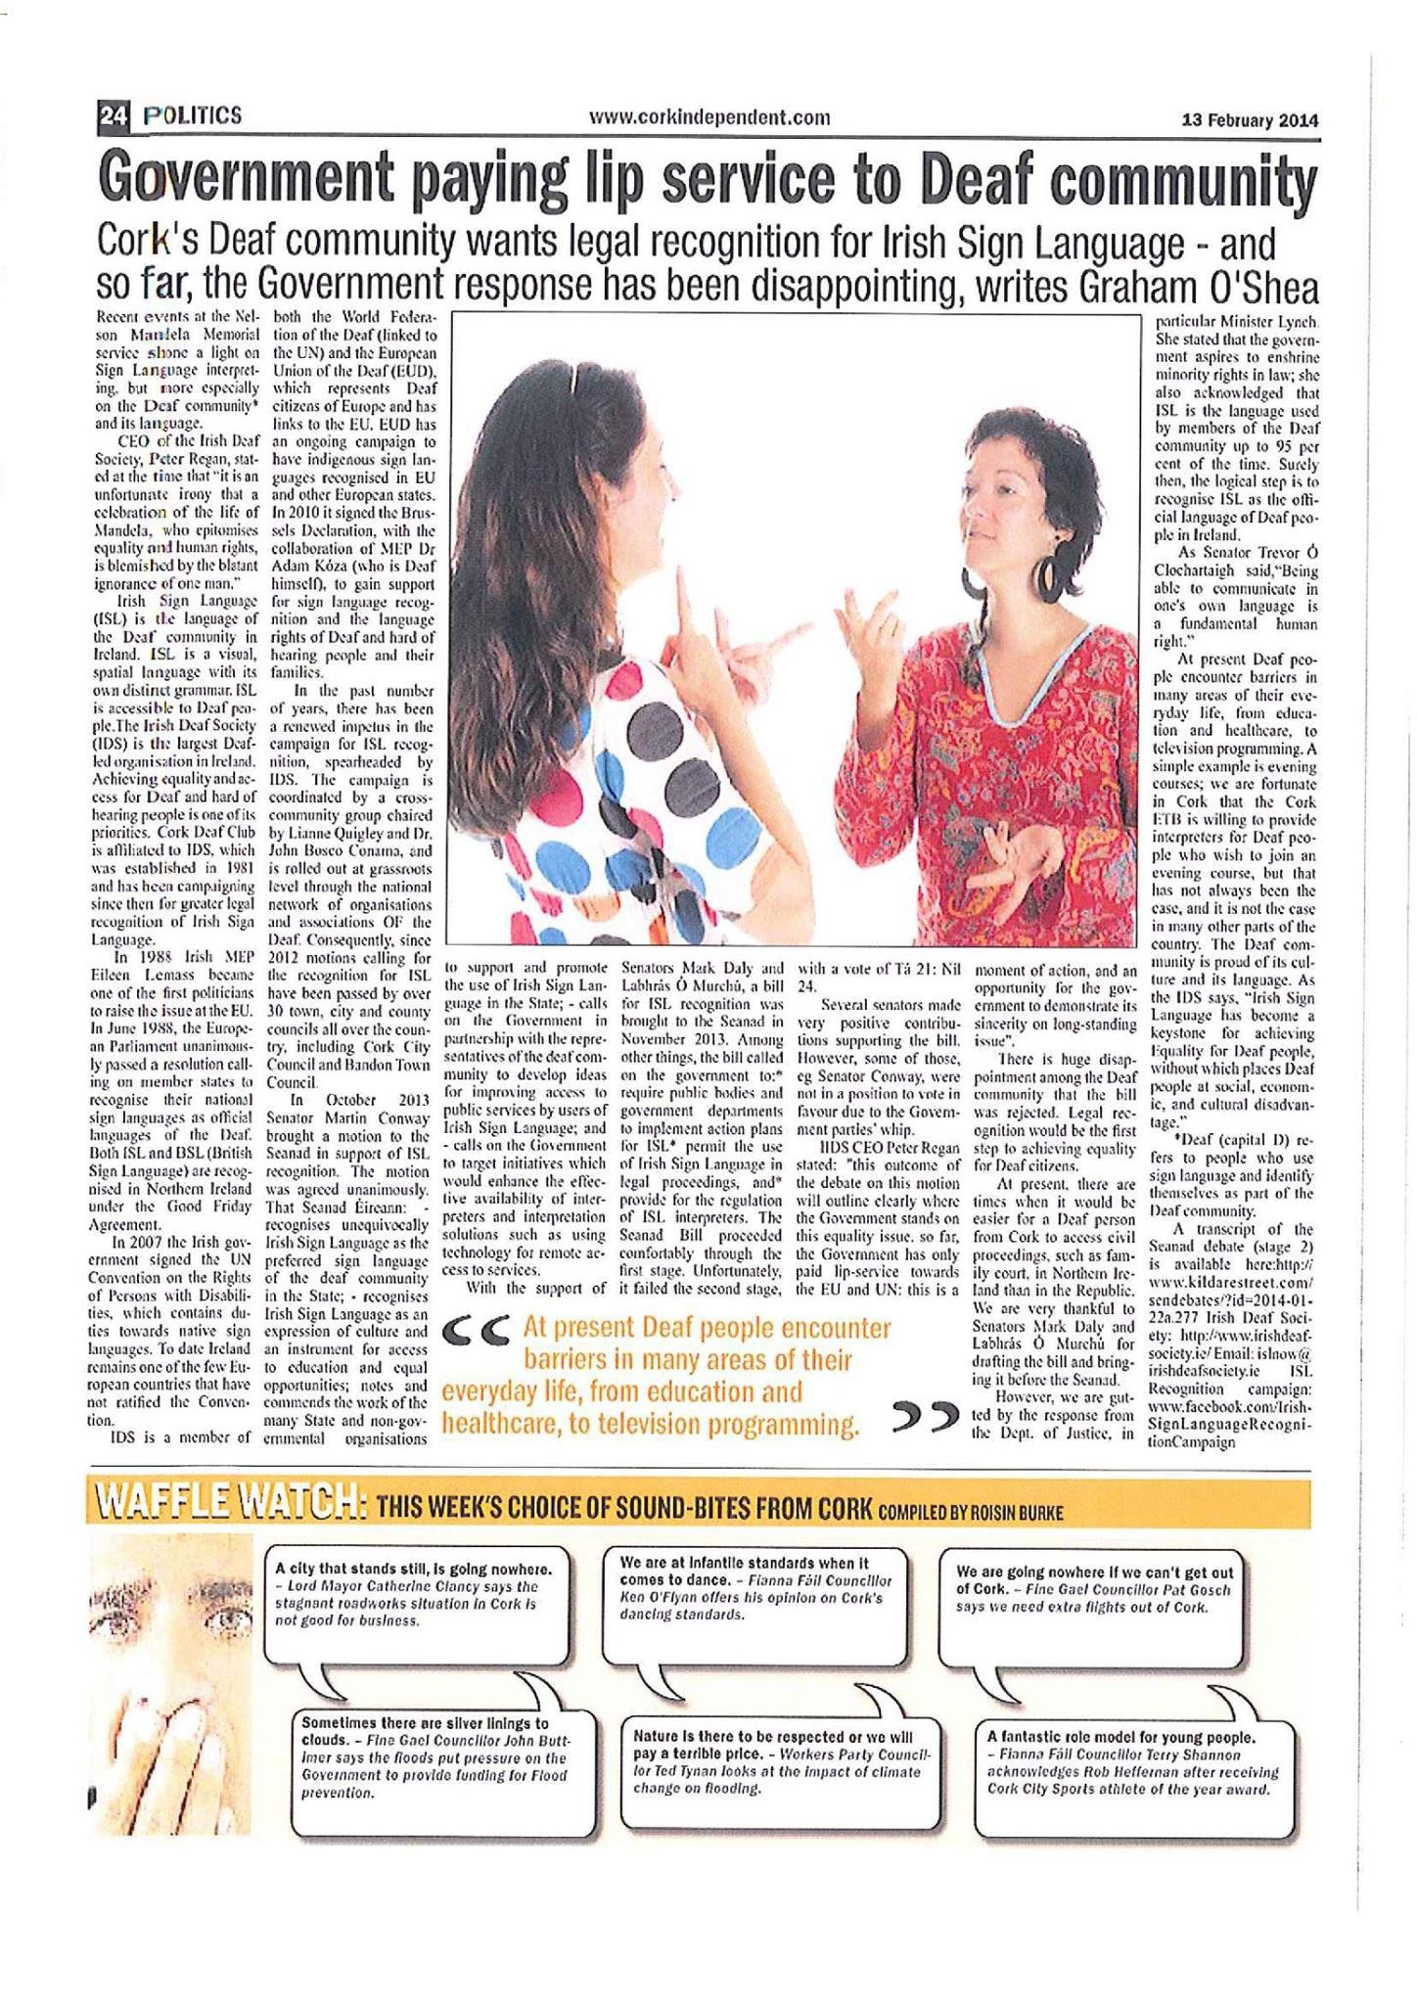
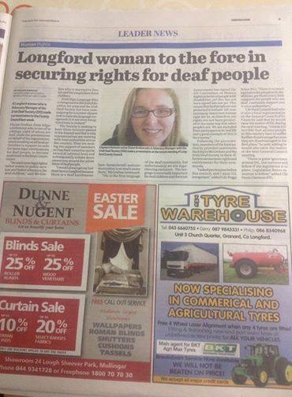
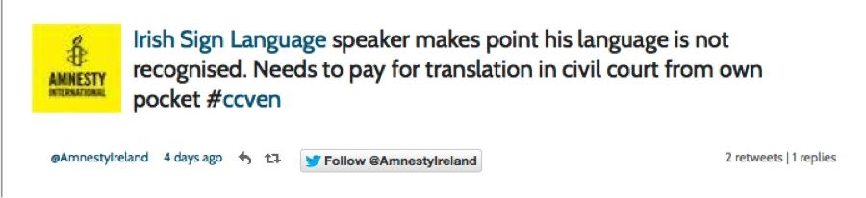
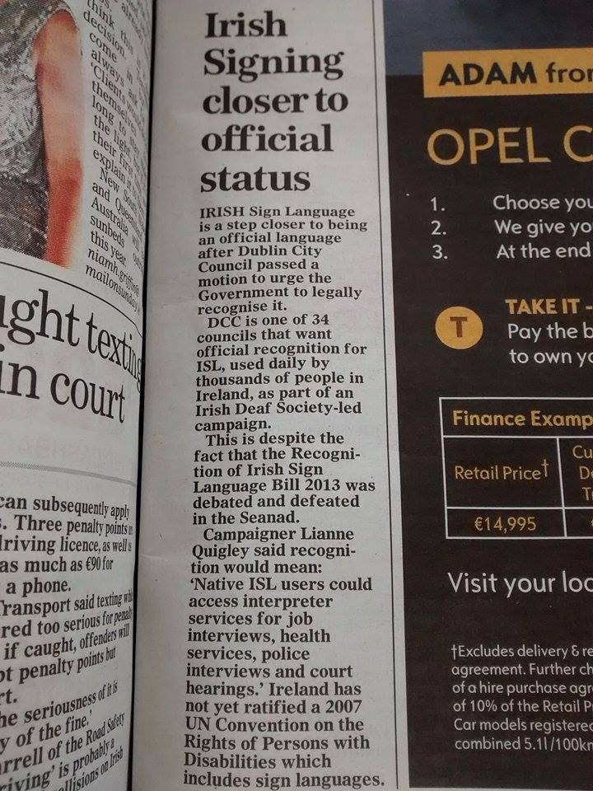
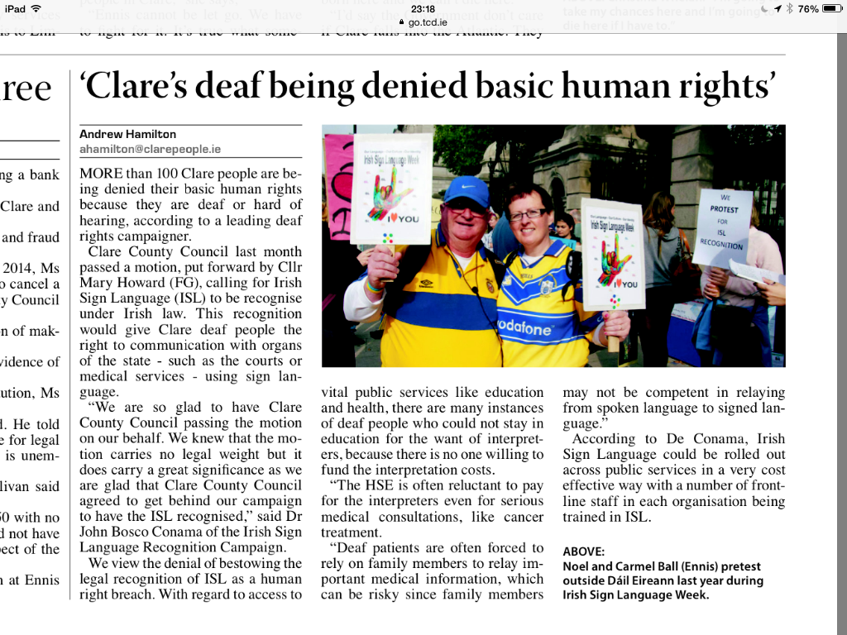
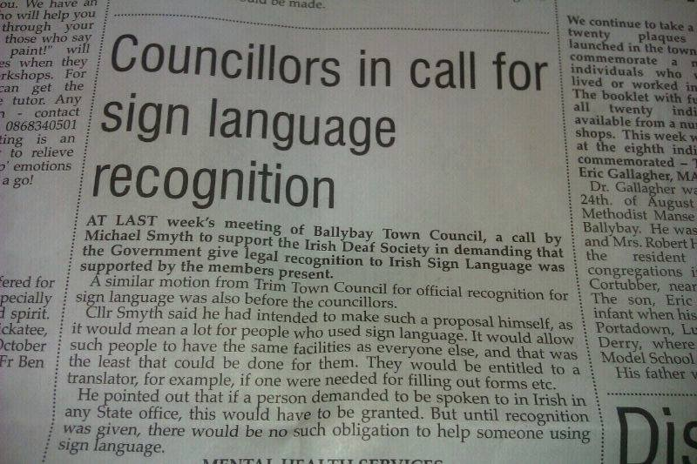
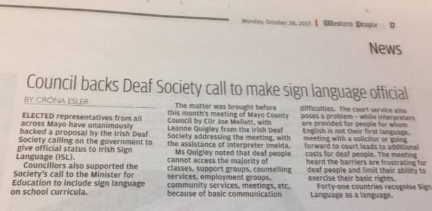

Slide 11


My observations / reflections

Slide 12

Linguistic imperialism
Linguistic imperialism is a term coined by Robert Phillipson to describe the exploitation of the ideological, cultural and elitist power of English for the economical and political advantage by dominant English speaking cultures (Rose and Conama 2017)

Slide 13
Linguistic imperialism examples during language recognition activism
Forced to negotiate or pay the costs of interpretation for meetings with policy makers
Telephone conversations unrecorded or undocumented among key players during negotiations
Deaf leadership being sidelined or undermined
Technological issues regarded as the “solutions”
Status of language in the Act “It is not just a vehicle for accessing information” (Daly 2017)
Education clauses “contingent upon a review and other issues” (ISL Act 2017)

Slide 14

Representation

Slide 15

Substantive representation
The concept of political representation is misleadingly simple: everyone seems to know what it is, yet few can agree on any particular definition (Stanford Encyclopedia Online)
UNCRPD Articles 4 and 29
Many political theorists suggest more focus on substantive representation of minorities to increase and sustain the visual presence of minorities
The politics of presence (Philips 1995)
However, substantive representation does not guarantee…

Slide 16


Re-phrasing Political Representation questions (copied and edited from Childs & Lovenduski 2013)
  Why should D(d)eaf people be represented?
  Who are the representatives of deaf people?
  Which deaf people are represented?
  Where does the representation of deaf people occur?
  How is the substantive representation of deaf people done?
  When does the representation take place?
  To whom are representatives accountable?
  How effective is the (claimed) representation?

Slide 17
Selected References
Childs, S., & Lovenduski, J. (2013). Political representation. In The Oxford handbook of gender and politics.
Conama, JB (forthcoming) Ah, that's not necessary, you can read English instead": An ecological analysis of state language policy concerning Irish Sign Language, Irish and English and its effects in Maartje de Meulder, Joseph Murray and Rachel McKee (eds) , Recognizing Sign Languages: An International Overview Of National Campaigns For Sign Language Legislation And Their Outcomes.
Conama JB (forthcoming) 35 Years and Counting! An Ethnographic Analysis of Sign Language Ideologies within the Irish Sign Language Recognition Campaign in Annelies Kusters (ed) , Sign Language Ideologies in Practice, De Gruyter, 201
De Meulder, M, J. Murray and R. McKee (eds) (forthcoming) , Recognizing Sign Languages: An International Overview Of National Campaigns For Sign Language Legislation And Their Outcomes.
Fraser, N. 2005. “Reframing Justice in a Globalizing World.” New Left Review 36: 1–19
Harvey, B. (2016). Local and Community Development in Ireland–An Overview. The Changing Landscape of Local and Community Development in Ireland: Policy and Practice, 7.
Mladenov, T. (2016). Disability and social justice. Disability & Society, 31(9), 1226-1241.
Phillips, A. (1995). The politics of presence. Clarendon Press.

