Slide 1
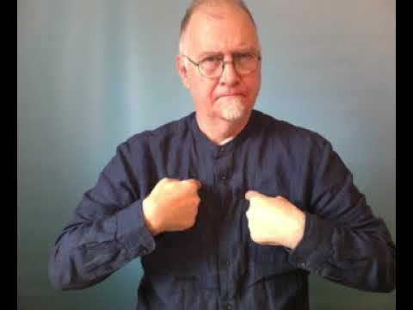
Credible Representation of us by us:
Impact & Implications
Jeff McWhinney
jeff@vortexconsult.com

Slide 2
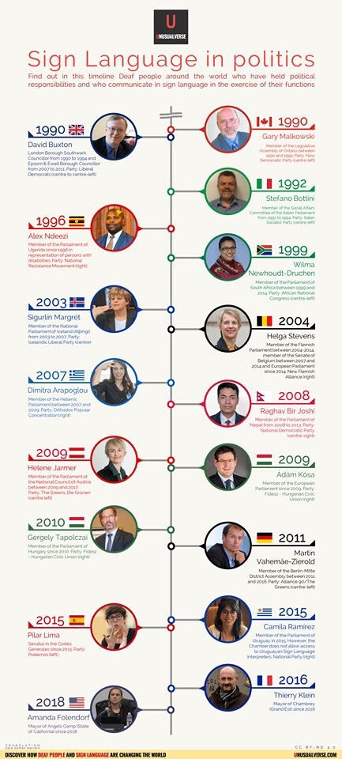
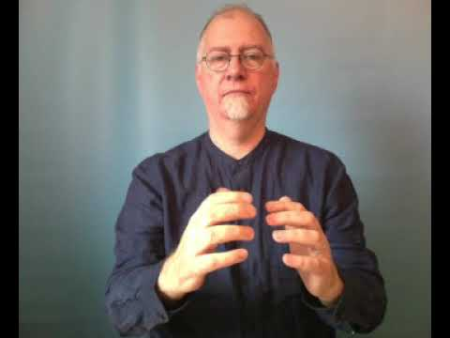
SL in politics a timeline…
Source: Tweet from Colin Allen @WFDPresident

Slide 3
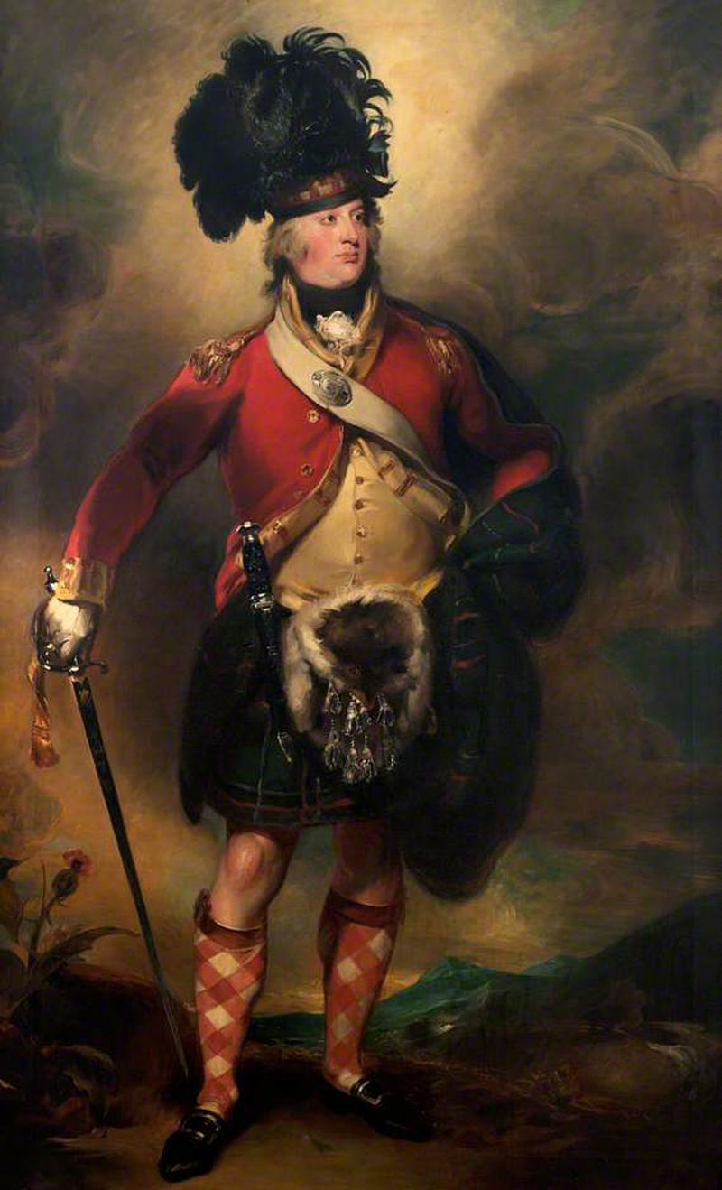
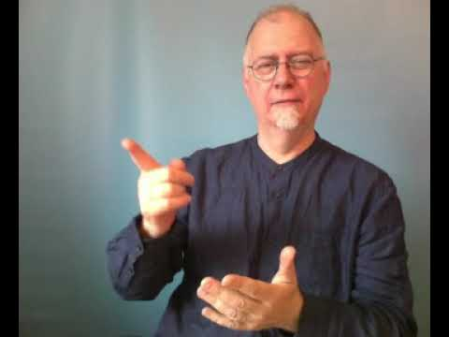
Sir Francis Humberston Mackenzie
In December 1783 John Robinson (a political analyst) wrote:
“As the chief of the Mackenzies, brother and heir of the late Colonel Humberston, is deaf and dumb, it is unlikely he will think of coming into Parliament and therefore it is most likely that Lord Macleod will be elected again.”
Sir Francis Humberston Mackenzie in spite of this prediction was elected to Parliament as MP for:
ROSS-SHIRE
1784 – 1790
And again for:
ROSS-SHIRE
1 May 1794 – 1796
MacKenzie served as Governor of Barbados from 1800 to 1806, during which period he reformed slavery on the island, established a prohibition of the killing of slaves, and reduced official discrimination against free black people.
Source: www.historyofparliamentonline.org

Slide 4

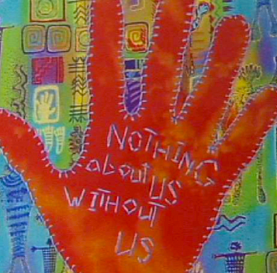
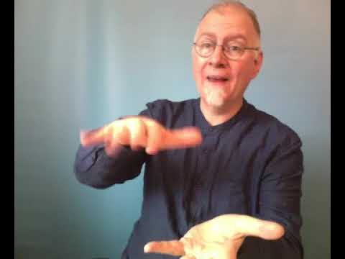
Source: Casyjot

Slide 5
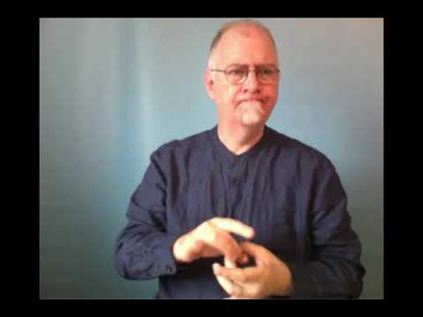
Credibility – as defined in Google Dictionary
Plausibility
Believability
Acceptability
Tenability
Cogency
Validity
Soundness
Veracity
Authenticity
Authoritativeness
Dependability
Trustworthiness
Clout
Innateness
Integrity

Slide 6
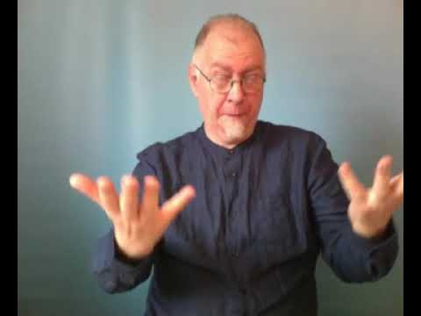
Credibility – as defined in Google Dictionary
Plausibility
Believability
Acceptability
Tenability
Cogency
Validity
Soundness
Veracity
Authenticity
Authoritativeness
Dependability
Trustworthiness
Clout
Innateness
Integrity
LANGUAGE & CULTURAL CREDIBILITY

Slide 7
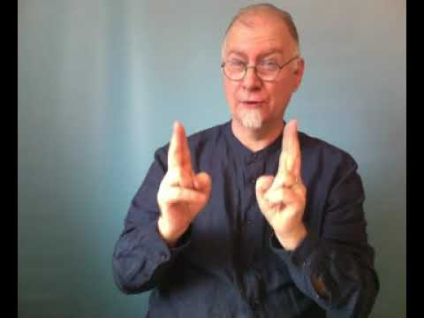
Language & Cultural Credibility
Language Credibility
BSL as a first or PREFERRED language
Seen by other BSL users(!) as a fluent BSL user(!)
Well versed in language issues i.e.:
  Language Deprivation
  Status as opposed to other languages, etc
Cultural Credibility
Seen as “D”eaf by all
Plugged within Deaf Community
Well versed in Deaf cultural issues i.e.:
  Direct rather than interpreted
  Proper cultural context in translation, etc

Slide 8
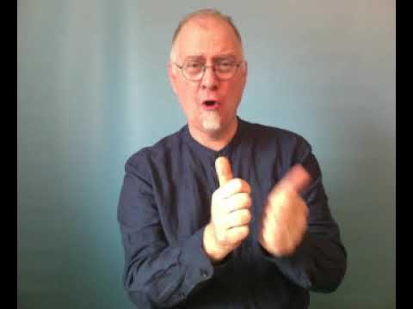
BSL Users - perception and time to redefine and gain credibility?

Slide 9
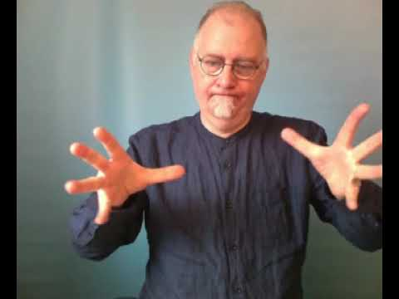
BSL USERS - Redefined
BSL usually said as “BaSiL” so why not call ourselves Basilians?
Basilians as first coined by the late Richard Magill

