Slide 1
Unaccompanied minors- the case of Norway
Her kan du skrive enhet/tilhørighet. Sett blank hvis dette ikke er aktuelt. Innhold i dette feltet styres her: Meny -> Sett inn (Mac=Vis) -> Topptekst og bunntekst
Ragnhild Hollekim, Dep. for Health and Development, University of Bergen
Marte Knag Fylkesnes, UNI Research, Bergen

Slide 2
Lecture outline
The Norwegian context
Numbers and trends
Changing patterns and policy
Immigration and resettlement
Working with young people in municipalities
Voices

Slide 3
The Norwegian context
Population: 5,2 million
Social-democratic welfare regime (Esping-Andersen, 2006)
Regulated market
Universal benefits and generous support systems
Trust based
Regional differences
422 municipalities

Slide 4
Numbers and trends (arrivals)
A peak in 2007-2009 (in 2009: 2500 UM arrived in Norway)
2010 – 2014: 1000 to 1200 pr. year
2015: All time high: 5480 (The «October children»)
2016: 320
2017: 191

Slide 5
2018 – asylum applications
Notes:
Hvorfor kommer de?

Slide 6
Who are they and where do they come from?
Most are boys
Most often:
15-17 years
from Afghanistan, Somalia, Iraq, Sri Lanka, Ethiopia and Eritrea
2015/2016: The biggest group came from Afghanistan (on average younger)
2017: The biggest group came from Eritrea, followed by Afghanistan and Syria

Slide 7
Changing patterns and policies: Residence
Historically, most UM have received permanent residency in Norway
In 2014, for example:
Permanent residence: 85%
Turned down: 4%
Temporary residence: 3%
Returned to other European countries: 2%
(Berg & Tronstad, 2015)

Slide 8
Increase in use of temporary residence permits
2009 – 2015: On average 4% (mainly an exemption clause)
2016: 14%
2017: 40%

Slide 9
Why?
Necessary to send a signal to the world to prevent more children to flee home country?
A «children’s best interest» argument
Changed regulations for returning youth to Afghanistan (lower threshold)

Slide 10
Consequences
Unsustainable integration processes established for large groups of youth
A large number of young people flee a second time, when they are about to turn 18
Serious mental stress/mental health problems made worse due to insecurity concerning residence
UM refugee- and asylumseekers, less protected that adult refugee- and asylum seekers?

Slide 11
Mental health aspects and UM – what do we know from research?
80 % experienced war. 50% (PTSD) (Oppedal et. al., 2011)
49% of UM under 15, experienced violence in close relationships before migration (Jensen et. al., 2014 – NKVTS)
Experiencing a variety of dangers while migrating
Asylum process – high level of stress, unpredictability
Vulnerability (Eide, 2012; Oppedal mfl., 2011)

Slide 12
The current political/societal debate in Norway
Children’s rights, «the best interest of the child» and immigration policy/goals
Children as instruments for sending political signals?
Temporary residence and expelled at the age of 18 - child abuse?
2017: Assessment for «specific vulnerability»

Slide 13
Working with young people in resettlement
Early years: 2002- 2007
Challenges:
Reception centers: staff, standard, follow-up
Childrens’ voices not heard in decision-making
No/little information from reception center
Challenging transition for youth - frustration

Slide 14
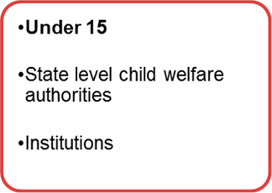
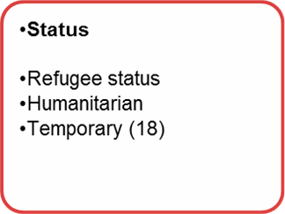
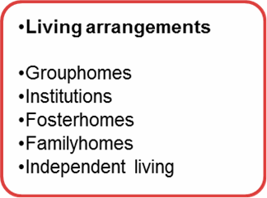
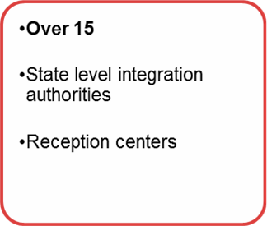
Pathway(s) to resettlement
Reception
Residency permit
Municipality
settlement
Seeking asylum
Interview
(police and gardian)
UN - refugees
Independence
Child welfare services
VS
Refugee services

Slide 15
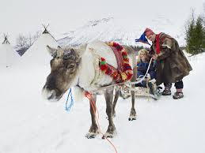
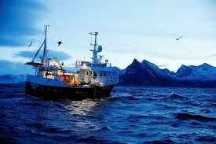
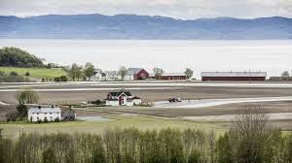
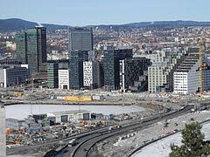
Variation

Slide 16
The case of Bergen
Planned transition: reception – municipality
Listening to young peoples wishes and perspectives
Focus: trusting relationships with adults
School, health, building networks
Child perspective and migrant perspective
Different living arrangements – individual needs

Slide 17
Living arrangements - research
Residential unit with full time staff
Staff:
Care and present staff
Daily routines
Safety and predictability
Community with other UM
Group home with part time staff
Staff: social worker leading
Young people help each other – each others resources
More freedom and independence
(Garvik et al, 2016)

Slide 18
Independent living
Flat with no/some follow up
Value: freedom and self-dependence, learning independence
Avoiding institutionalisation
Young people miss: support and follow-up
Feel unsafe and lonely
Recommended: as transition out-of-care + for older youth
(Garvik et al, 2016)

Slide 19
Foster homes
Knowledge gap
Policies in general - push towards foster home placement
Stable relationships and safety
Knowing «culture» and learning the language
Support in transition towards adulthood
Challenge: placement break downs
Recruiting suitable families
Young people: miss community of UM

Slide 20
Some challenges
Changing immigration patterns – implications for services
School
Negative attitudes and discrimination
Integration and sense of belonging

Slide 21
Young peoples voices
Example from research

